Slide 1

Stats Bootcamp
MSc in Analytics
Dr. Anil D Chaturvedi
Email: anilchaturvedi@uchicago.edu
Phone: 301-299-2434

Slide 2
Welcome to Stats Bootcamp

Slide 3
Session 1: Topics
Course Goals
Course Structure
Grading Structure
Framework for Information extraction
The statistical/scientific approach
Multi linear models and special cases

Slide 4
Course Goals
Introduction to basic concepts in Statistics
Univariate and Bivariate Data
Introductory Inference via Hypotheses Testing
Introduction to Ordinary Least Squares Regression
Introduction to Analysis of Variance

Slide 5
Course Structure
The course has two components
Weekly individual homework assignments
Quizzes

Slide 6
Grading Structure
Component | Grade | Cumulative
Homework Assignments | 80% | 80%
Quizzes | 20% | 100%

Slide 7
Other Announcements
You can reach me via email: anilchaturvedi@uchicago.edu
There will be some opportunities for bonus points (5%-10%) during the class
Ensure work is original
Ensure respect for Group members and their time commitments
Ensure contribution to Groups is fair and even

Slide 8
Other Announcements
Participate in Class!
Helps improve the thought process

Slide 9
Other Announcements
Stop worrying about Grades
And
Enjoy the Learning Experience!

Slide 10
Other Announcements
Introduction

Slide 11
What are Statistics?
Statistics are facts and figures.
Consider some examples...
Notes:
What are Statistics?
Statistics are facts and figures.
Consider some examples…

Slide 12

Earthquake damage
Notes:
The largest earthquake measured 9.2 on the Richter scale.

Slide 13

common
murder
weapon
Notes:
Men are at least 10 times more likely than women to commit murder.

Slide 14
Statistics...
Rely upon the calculation of numbers.
Rely upon how the numbers are chosen and how the statistics are interpreted.
Sometimes have problematic interpretations.
Consider some examples…
Notes:
Statistics rely heavily upon the calculations of numbers.
But statistics also rely heavily on how the numbers are chosen and how the statistics are interpreted.
And sometimes the interpretations are problematic!
Consider some examples…and try to identify a major flaw with each interpretation.

Slide 15

Statistics Example #1: Ice Cream
Notes:
Here you see a picture of some delicious ice cream...

Slide 16
A new advertisement for Ben and Jerry's ice cream introduced in late May of last year resulted in a 30% increase in ice cream sales for the following three months. Thus, the advertisement was effective.
...Problems with this logic?
Notes:
Consider that a new advertisement for Ben and Jerry's ice cream introduced in late May of last year resulted in a 30% increase in ice cream sales for the following three months. Thus, the advertisement was effective.
Question:
Are there any problems with this logic?

Slide 17
Yes!
Ice cream consumption typically increases in summer months
Thus, there is a “history effect”
Notes:
Yes! A major flaw is that ice cream consumption generally increases in the months of June, July, and August regardless of advertisements. This effect is called a history effect and leads people to interpret outcomes as the result of one variable when another variable (in this case, one having to do with the passage of time) is actually responsible.

Slide 18

Statistics Example #2: Churches and Crime
Notes:
In a second example, I would like you to consider the relationship between churches and crime. In fact...

Slide 19
The more churches in a city, the more crime there is. Thus, churches lead to crime.
...Problems with this logic?
Notes:
The more churches in a city, the more crime there is. Thus, churches lead to crime.
Question:
Are there any problems with this logic?

Slide 20
Yes!
Increased churches and increased crime rates can be explained by larger populations.
Thus, there is a potential “third variable problem.”
Notes:
Yes! A major flaw is that both increased churches and increased crime rates can be explained by larger populations. In bigger cities, there are both more churches and more crime. This problem, which we will discuss in more detail in a later chapter refers to the third variable problem. Namely, a third variable can cause both situations; however people erroneously believe that there is a causal relationship between the two primary variables rather than recognize that a third variable can cause both.

Slide 21

Statistics Example #3: Interracial Marriages
Notes:
As a third example, I would like you to consider the number of interracial marriages that are now occurring in our society...

Slide 22
The proportion of inter-racial marriages this year is 75% higher than it was 25 years ago. Thus, our society accepts interracial marriages.
...Problems with this logic?
Notes:
The proportion of inter-racial marriages this year is 75% higher than it was 25 years ago. Thus, our society accepts interracial marriages.
Question:
Are there any problems with this logic?

Slide 23
Yes!
What is the rate at which marriages are occurring? Are there fluctuations in the rate of interracial marriages?
Sometimes, we simply don't have the information that we need to understand the impact of statistics.
Notes:
Yes!! A major flaw is that we don't have the information that we need. What is the rate at which marriages are occurring? Suppose only 1% of marriages 25 years ago were interracial and so now 1.75% of marriages are interracial (1.75 is 75% higher than 1). But this latter number is hardly evidence suggesting the acceptability of interracial marriages. In addition, the statistic provided does not rule out the possibility that the number of interracial marriages has seen dramatic fluctuations over the years and this year is not the highest. Again, there is simply not enough information to understand fully the impact of the statistics.

Slide 24
In sum, statistics are NOT just facts and figures. They are techniques and procedures for analyzing, interpreting, displaying, and making decisions based on data.
Notes:
In sum, statistics are NOT just facts and figures.
They are more than that.
Rather, "statistics" refers to a range of techniques and procedures for analyzing, interpreting, displaying, and making decisions based on data.

Slide 25
Importance of Statistics
It may be the single most important subject matter you study.
You will continue to inundated with statistics throughout your life.
Consider some examples...
Notes:
Statistics may be the single most important subject matter that you ever study. This is because throughout your entire life you have been and will continue to be inundated with research statistics and findings. These are just a few examples you might have encountered:

Slide 26
Examples of Statistics
People tend to be more persuasive when they look others directly in the eye and speak loudly and quickly.
Women make 75 cents to every dollar a man makes at the same job.
Eating egg whites can increase life span.
79.48% of all statistics are made up on the spot (just kidding!).
Notes:
.
- People tend to be more persuasive when they look others directly in the eye and speak loudly and quickly.
- Women make 75 cents to every dollar a man makes when they work the same job.
- A surprising new study shows that eating egg whites can increase one's life span.
People predict that it is very unlikely there will ever be another baseball player with a batting average over 400.
- 79.48% of all statistics are made up on the spot.

Slide 27
Some of These Statistics are Not True.
But they are universal.
They seem to add credibility.
It is important to become a consumer of research and of statistics.
Notes:
Although some of these statistics are not true, you can see from this list of examples that statistics are ubiquitous: They are everywhere. They are in psychology, health, law, sports, in business, and in every other discipline.
Statistics are often included in reports to add credibility. This is easily observed watching any of the major news shows. Many of the statistics presented to you in your life have not been, are not, and will not be accurate. These snappy numbers are often easily accepted and mislead people, especially people who are not informed about research and statistics.
It is extremely important to understand statistics because statistics influence which findings you are going to believe and which findings are going to influence you to make changes in your life. And this statistics textbook is important because it's going to make you an informed consumer of statistics.

Slide 28
First step: Question statistics “There are three kinds of lies -- lies, damned lies, and statistics.” - Benjamin Disraeli, Former British Prime Minister
Notes:
The first step to being a consumer of statistics will be to question the statistics that you encounter. The British Prime Minister Benjamin Disraeli was quoted by Mark Twain as having said, "There are three kinds of lies -- lies, damned lies, and statistics." This quote reminds us why it is so important to understand statistics. From now on, don't just blindly accept numbers or findings but look carefully at the numbers, the sources, and most importantly, the procedures researchers use to obtain their findings. But just as important as detecting the deceptive use of statistics is the appreciation of the proper use of statistics. You should be able to recognize situations where the statistical evidence strongly supports conclusions. As you think more about statistics, you will become increasingly aware that statistics are all around you.

Slide 29
Descriptive Statistics
Used for organizing, summarizing, and describing data.
Examples: percentages, frequencies, averages, graphs, tables
Versus inferential Statistics
Let’s consider examples of descriptive statistics...
Notes:
Descriptive statistics are used for organizing, summarizing, and describing data. They include the use of percentages, frequencies, averages, graphs, and tables. They do not involve generalizing beyond the data at hand. Generalizing from a sample to the population it was sampled from is the domain of inferential statistics.
Let’s consider some examples.

Slide 30

Average Salaries for Various Occupations in 1999
112,760 – pediatricians
106,130 – dentists
100,090 – podiatrists
76,140 - physicists
53,410 - architects,
49,720 - school psychologists
47,910 - flight attendants
39,560 - elementary teachers
38,710 - police officers
18,980 - floral designers
Notes:
This table shows the average salaries for various occupations in 1999.
These statistics are referred to as descriptive statistics because, as the name suggests, they describe the data. Indeed, descriptive statistics are important and give us a great deal of information, in this case, about the different salaries that individuals make. It is interesting to note, for instance, that we pay the people who educate our children and who protect our citizens a great deal less than we pay people who take care of our feet or our teeth.

Slide 31
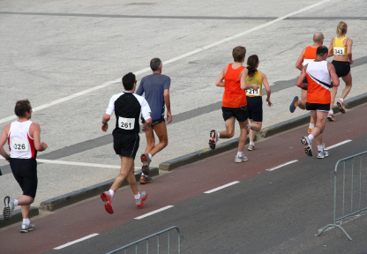
Will the gender gap close? How much faster can
runners go? Is a sub-2 hour marathon possible?
Notes:
These statistics might further lead us to question whether the gender gap will close or remain constant. We might also look at the times within each gender and wonder just how far they will decrease. For instance, do you think, from looking at the numbers, that we will ever witness a marathon runner who runs a sub-2 hour marathon? These are the sorts of questions that statistics allow us to ask and we remind you to start thinking of these questions when you encounter statistics.

Slide 32
Inferential Statistics
With inferential statistics, we take a sample, or a small subset of a larger set of data.
We then use this sample to draw inferences about the population as a whole.
Let’s consider a few examples...
Notes:
With inferential statistics, we generally take a sample, or a small subset of a larger set of data, and we use this sample to draw inferences about the population as a whole.
Let’s consider some examples...

Slide 33
Simple Random Sampling
Every member of the population has an equal chance of being selected into the sample.
The selection of one member is independent from the selection of another member.
Thus, it is selection by pure chance.
Notes:
As you might imagine, it is very easy for a sample to be biased. Thus, there are strategies that researchers adopt in an attempt to eliminate or decrease the bias in their sample. One of these strategies is the use of simple random sampling. Simple random sampling occurs when every member of the population has an equal chance of being selected into the sample. In addition, the selection of one member is independent from the selection of another member. In theory, then, the strategy of simple random sampling involves selection into a sample by pure chance.

Slide 34
Importance of Random Sampling
If we do not sample by pure chance, problems can result.
Consider the following examples...
Notes:
To see why random sampling is important, consider the following ways that a sample can be obtained. To build on your understanding of sample and population, identify both of these and then consider the problem(s) with how the sample was selected.

Slide 35
Sampling Example 1
A substitute teacher wants to know how students in the class did on their last test.
She asks only the 10 students sitting in the front row to report how they did on their last test and she concludes from them that the class did extremely well.
Sample? Population? Problems?
Notes:
In this example, a substitute teacher wants to know how students in the class did on their last test. She asks only the 10 students sitting in the front row to report how they did and concludes that the class did extremely well. What is the sample? What is the population? Can you identify any problems with choosing the sample in the way that the teacher did?

Slide 36
Answers
The sample is the 10 students sitting in the front row.
The population is all students in the class.
The problem is that the sample is biased.
Notes:
- The sample is the 10 students sitting in the front row.- The population is all students in the class.- The problem with choosing this sample is that it is biased. Those who sit in the front row of classes tend to be more interested in the class and tend to perform higher in the class than the students who sit in other places in the classroom. Thus, the sample may be performing much better than the population. If the substitute teacher puts every student's name in a hat and randomly chooses 10 names out of the hat, the sample would not be biased. Consider another example...

Slide 37
Sampling Example 2
A coach is interested in seeing how many cartwheels the average college freshman at his university can do.
The coach chooses eight volunteers, all of whom happen to be women, and concludes that college freshmen can do an average of 16 cartwheels in a row without stopping. Sample? Population? Problems?
Notes:
In this example, a coach is interested in seeing how many cartwheels the average college freshman at his university can do. The coach chooses eight volunteers, all of whom happen to be women, and concludes that college freshmen can do an average of 16 cartwheels in a row without stopping. What is the sample? What is the population? Can you identify any problems with choosing the sample in the way that the coach did? The sample includes the female students who volunteered to do cartwheels. - The population includes all freshmen at the university where the study was conducted. - The problem with choosing this sample is that, again, random sampling was not used and so generalizations back to the population can be grossly inaccurate. Rather than randomly sample from all college freshmen and ask them to turn cartwheels, the coach chose only women and chose only those who volunteered. First, we might assume that women generally outperform men in turning cartwheels (more women are in gymnastics, cartwheels tend to be an activity that little girls pursue more than boys) and so the number 16 would be biased. Second, those that volunteer to do cartwheels can probably do cartwheels very well. In other words, a person who can't do cartwheels probably would not volunteer to do them. Thus, the sample may be missing individuals who suffer in cartwheel abilities and hence, the sample inflates the number relative to the population.

Slide 38
Problems
Can be difficult to obtain
Not necessarily representative
Large sample sizes help
Notes:
Sometimes, it is simply not possible or feasible to take a simple random sampling. For instance, consider that both Dallas and Houston were vying to be hosts of the 2012 Olympics. And assume you were hired to assess whether Texans, as a whole, would prefer the Olympics to be in Dallas or Houston. Because you have already learned the difficulty of getting every single Texan's opinion, you know you must get a sample and you want to use a simple random sampling. However, even this may be very difficult. For instance, how will you get a hold of those individuals who don't vote, who don't have phones, and whose addresses have changed? What do you do with those individuals in the sample who happened to move from Texas to California? What do you do about the fact that since the beginning of the study, an additional 4,212 people moved to the state of Texas? As you can see, it is sometimes very difficult to develop a truly random procedure.
Recall that the definition of a random sample is a sample in which every member of the population has an equal chance of being selected. This means that the sampling procedure rather than the results of the sampling procedure defines what it means for a sample to be random. Random samples, especially if the sample size is small, are not necessarily even roughly representative of the population. For example, if a random sample of 12 were taken from a population with an equal number of males and females, there would be approximately a 1 in 5 chance that two thirds or more of the sample would be female. Such a sample would not be representative, although it would be random. In short, only with a large sample size will a random sample ensure an approximately representative sample.

Slide 39
Variables
Variables are properties or characteristics of some event, object, or person that can take on different values or amounts.
Constants do not vary.
Notes:
Variables are properties or characteristics of some event, object, or person that can take on different values or amounts (as opposed to constants, such as the mathematical constant pi, which do not vary). Let's look at a few examples.

Slide 40
Identify Variables
Notes:
Here you can see 3 dogs of different breeds. Can you think of ways in which these 3 dogs vary? In other words, can you think of some properties or characteristics of these dogs that can take on different values or amounts?

Slide 41
Examples of variables
Dogs of different breeds vary in:
height
weight
color
length of hair (long or short)
body shape
purpose
Notes:
These three dogs vary in height, weight, color, length of hair, body shape, purpose for which they were bred, and so forth.

Slide 42
Dogs
Notes:
Here are some dogs that vary on many dimensions. They vary on breed, height, weight, color, among other things.

Slide 43
How do these fish vary?
Notes:
Here’s another example. Can you think of ways these fish vary? Well, they vary in species, shape, weight, type of water they live in (saltwater or fresh), etc.

Slide 44
Independent Variables
Independent Variable
A variable the experimenter manipulates
Example: Type of anti-depressant
Notes:
Now let’s learn about variables in more depth. When conducting research, experimenters often manipulate variables. For example, an experimenter might compare the effectiveness of four types of antidepressants. When a variable is manipulated by an experimenter, it is called an independent variable. Therefore, “type of anti-depressant” is an independent variable.

Slide 45
Dependent Variables
Dependent Variable
The variable the experimenter measures
Example: Amount of relief
Sometimes called “dependent measure”
Notes:
In this example about anti depressants, the experimenter seeks to determine the effect of the independent variable (type of anti-depressant) on the level of depression. The measure of the severity of depression is the dependent variable. The dependent variable is used to assess the effect of the independent variable. Dependent variables are sometimes called “dependent measures.”

Slide 46
Independent and Dependent Variables
Identifying independent variables (IV) and dependent variables (DV) is important and requires practice.
Notes:
Identifying independent and dependent variables is one of the first tasks of a researcher, and, initially, many students find this task difficult. The easiest way to improve your ability to identify these variables is to practice, practice, practice. You will now get a chance for some practice.

Slide 47

Study 1: Blueberries and Aging
Independent variable?
Dependent variable?
Notes:
Example #1: Can blueberries slow down aging? A study indicates that antioxidants found in blueberries may slow down the process of aging. In the study, 19-month old rats (equivalent to 60-year old humans) were fed either their standard diet or a diet supplemented by either blueberry, strawberry, or spinach powder. After eight weeks, the rats were given memory and motor tests. Although all supplemented rats showed improvement, those supplemented with blueberry powder showed the most notable improvement.
What is the independent variable? And, what are the dependent variables?

Slide 48
Study 1: Blueberries and Aging
Diet is the IV
Motor and memory tests are the DVs
Notes:
The independent variable is the variable that the experimenter manipulated, namely the rats’ diet. There were four levels of the independent variable, the control (no supplement), blueberries, strawberries, and spinach powder.
The dependent variables are the variable that measure the effects of the independent variable. In this case, the motor and memory tasks are the dependent variables. So, the experimenter manipulated the rats’ supplement intake and measured the effect of these different supplements (or no supplement) on motor and memory tasks. Learning to identify independent and dependent variables is a difficult task, so let’s do another example.

Slide 49

Study 2: Beta-carotene and Cancer
Independent variable?
Dependent variable?
Notes:
Example #2: Does beta-carotene protect against cancer? Beta-carotene: Does it or doesn't it? Beta-carotene supplements had been thought to protect against cancer, but a study published in the Journal of the National Cancer Institute suggests that it does not. The study was conducted with 39,000 women aged 45 and up. These women were randomly assigned to receive a beta-carotene supplement or a placebo, and their health was studied over time. There was no evidence that taking the beta-carotene supplement affected their cancer rates.
Once again, what is the independent variable? And, what is the dependent variable?

Slide 50
Study 2: Beta-carotene and Cancer
Type of supplement is the IV
Cancer rates is the DV
Notes:
The independent variable is the variable that the experimenter manipulated, namely the supplement (beta-carotene or a placebo). There were two levels of the independent variable, the control (no supplement) and the beta-carotene. The dependent variable is the variable that measures the effects of the independent variable, in this case, cancer rate. So, the experimenter manipulated the administration of beta-carotene and measured its effect on cancer rates. Let’s do one more example.

Slide 51


Study 3: How Bright is Right?
Independent variable?
Dependent variable?
Notes:
Example #3: How bright is right? An automobile manufacturer wants to know how bright brake lights should be to minimize the time required for the driver of a following car to brake. What is the independent variable? And, what is the dependent variable? This is a more difficult example because fewer details are provided, giving you fewer clues.

Slide 52
Study 3: How Bright is Right?
Brightness of brake lights is the IV
Braking time is the DV
Notes:
The independent variable is the variable that the experimenter manipulated, namely the brightness of the brake lights. Note that no details are given as to the brightness of the lights or how many levels of the independent variable were tested. The dependent variable is the variable that measures the effects of the independent variable, in this case, “time to hit the brakes.” So, the experimenter manipulated the brightness of brake lights and measured the effect on driver stopping time.

Slide 53
Qualitative and Quantitative Variables
Qualitative variables express a “quality”
Quantitative variables are measured numerically.
Notes:
Variables can be either qualitative or quantitative. Qualitative variables are those that express a qualitative attribute such as hair color, eye color, religion, favorite movie, gender, and so on. The values of a qualitative variable do not imply any kind of ordering. Values of the variable “religion” differ qualitatively; no ordering of religions is implied. Quantitative variables are those variables that are measured in terms of numbers. Some examples of quantitative variables are height, weight, and shoe size.

Slide 54
Qualitative and Quantitative Variables
“Type of supplement” is a qualitative variable.
“Memory test score” is a quantitative variable.
Notes:
In the previously discussed study on the effect of blueberries and aging, the independent variable was type of supplement: none, strawberry, blueberry, and spinach. The variable "type of supplement" is a qualitative variable; there is nothing numeric about it. In contrast, the dependent variable "memory test score" is a quantitative variable since memory performance was measured on a quantitative scale (number correct).

Slide 55
Discrete and Continuous Variables
Discrete variables
Take on only certain values.
Continuous variables
Can take on any value within the range of the scale.
Notes:
Another important distinction is between discrete and continuous variables. Discrete variables can take on only certain values. Continuous variables can (theoretically) take on any value within the range of the scale.

Slide 56

Discrete and Continuous Variables
Number of children: A discrete variable
Notes:
Variables such as number of children in a household are called "discrete variables" since the
possible scores are discrete points on the scale. For example, a household could have three children or six children, but not 4.53 children.

Slide 57
Discrete and Continuous Variables
Time to respond to a question:
A continuous variable
Notes:
Other variables such as "time to respond to a question" are continuous variables since the scale is continuous and not made up of discrete steps. The response time could be 1.64 seconds, or it could be 1.64237 seconds. Of course, the practicalities of measurement preclude most measured variables from being truly continuous.

Slide 58
Percentiles
A raw score is difficult to interpret by itself
Your score on a shyness test is 35/50.
Does this mean you are shyer then most people?
Notes:
As part of a course on tests and measurements you take a test designed to measure shyness. Your score is 35 out of a possible 50. Does this mean you are shy? Or that you are shyer than most people? You really can’t say without more information. Think about what other information would be helpful?

Slide 59
What Proportion of Scores is Your Score Higher Than?
Your shyness score’s percentile is very informative.
If your shyness score is higher than 65% of the population, then your score is the 65th percentile.
Notes:
If your score of 35 was higher than 99% of the population, then you would be one of the shyest people around. On the other hand if your score was higher than only 1% of the population then you would be one of the least shy. Your percentile is the proportion of the population you scored higher than. Let's say that your score was higher than 65% of the population. Then your score would be the 65th percentile.

Slide 60
Simple Definitions
Lowest score that is greater than 65% of the scores.
Lowest score that is greater than or equal to 65% of the scores
Notes:
There is no universally accepted definition of percentile. Practically speaking, it doesn’t make much difference which definition is used when you have a lot of data. However, different definitions can lead to dramatically different results when there is relatively little data.
There are two simple definitions of percentile. We will use the 65th percentile as an example. According to the first definition, the 65th percentile is the lowest score that is greater than 65% of the scores. This differs slightly from the second definition that considers the 65th percentile to be the lowest score that is greater than OR EQUAL to 65% of the scores.

Slide 61
Rounding?
Neither definition is explicit about rounding.
What score is higher than 65% of 50 scores?
Notes:
Neither of these simple definitions is explicit about how to round off. For example, determining the 65th percentile of a set of 50 scores is problematic since 65% of 50 is 32.5. You could round off and define the 65th percentile as the lowest score greater than 32 of the scores or you could define it as the the lowest score greater than 33 scores.

Slide 62
Definition 3
More complex
Explicit about rounding
Compromise between first two definitions
Makes the median the 50th percentile
Covered in the text
Notes:
There is a third definition, that despite being more complex than the other two has several advantages. First, it is explicit about rounding. Second, it represents a compromise between the first two, resulting in a value between them. Finally, it allows the median ( a measure of central tendency) to be defined as the 50th percentile.
The formulas for this third definition are given in the standard mode. Unless otherwise specified, when we refer to "percentile," we will be referring to this third definition of percentiles.

Slide 63
Scales of Measurement
We measure our dependent variables
Different types are measured differently.
Notes:
Before we can conduct a statistical analysis, we need to measure our dependent variables. Exactly how the measurement is carried out depends on the type of variable involved in the analysis. Different types are measured differently. To measure the time taken to respond to a stimulus, you might use a stop watch. Stop watches are of no use, of course, when it comes to measuring someone's attitude towards a political candidate. A rating scale is more appropriate in this case (with labels like "very favorable," "somewhat favorable" etc.). For a dependent variable such as "favorite color," you can simply note the color-word (like "red") that the subject offers.

Slide 64
Types of Scales
Four fundamental scales:
Nominal
Ordinal
Interval
Ratio
Notes:
Although procedures for measurement differ in many ways, they can be classified using a few fundamental categories. In a given category, all of the procedures share some properties that are important for you to know about. The categories are called "scale types," or just "scales," and are described in this section. There are 4 basic scales of measurement: nominal, ordinal, interval, and ratio.

Slide 65
Nominal Scales
Nominal:
names or categorizes
examples include:
gender
handedness
favorite color
religion
lowest level of measurement
Notes:
When measuring using a nominal scale, one simply names or categorizes responses. Gender, handedness, favorite color, and religion are examples of variables measured on a nominal scale. The essential point about nominal scales is that they do not imply any ordering among the responses. For example, when classifying people according to their favorite color, there is no sense in which green is placed "ahead of" blue. Responses are merely categorized. Nominal scales embody the lowest level of measurement.

Slide 66
Ordinal Scales
Ordinal:
names or categorizes and the order is meaningful
examples include:
consumer satisfaction ratings
military rank
class ranking
Notes:
The next highest scale of measurement is ordinal. The ordinal scale is used when one wishes to name or categorize and the order is meaningful. Let's look an an example. A researcher wishing to measure consumers' satisfaction with their microwave ovens might ask them to specify their feelings as either "very dissatisfied," "somewhat dissatisfied," "somewhat satisfied," or "very satisfied." The items in this scale are ordered, ranging from least to most satisfied. This is what distinguishes ordinal from nominal scales. Whereas nominal scales don't allow comparisons in the degree to which two subjects possess the dependent variable, just this kind of comparison is possible with ordinal scales. For example, our satisfaction ordering makes it meaningful to assert that one person is more satisfied than another with their microwave ovens. Other examples of variables measured at the ordinal level are military rank (private, lieutenant, captain, general, etc.), and class ranking (first in class, second in class, and so on).

Slide 67
Limitations of Ordinal Scales
Ordinal scales are limited:
can’t assume the differences between adjacent scale values are equal
Can’t make this assumption even if the labels are numbers, not words
Notes:
Ordinal scales fail to capture important information that will be present in the other scales we examine. In particular, the difference between two levels of an ordinal scale cannot be assumed to be the same as the difference between two other levels. In our satisfaction scale, for example, the difference between the responses "very dissatisfied" and "somewhat dissatisfied" is not necessarily the same as the difference between "somewhat dissatisfied" and "somewhat satisfied." Nothing in our measurement procedure allows us to determine whether the two differences reflect the same difference in psychological satisfaction. Statisticians express this point by saying that the differences between adjacent scale values do not necessarily represent equal intervals on the underlying scale giving rise to the measurements. (In our case, the underlying scale is the true feeling of satisfaction, which we are trying to measure.)
What if the researcher had measured satisfaction by asking consumers to indicate their level of satisfaction by choosing a number from one to four? Would the difference between the responses of one and two necessarily reflect the same difference in satisfaction as the difference between the responses two and three? The answer is "No." Changing the response format to numbers does not change the meaning of the scale. We are still in no position to assert that the mental step from 1 to 2 (for example) is the same as the mental step from 3 to 4.

Slide 68
Interval Scales
Interval:
names or categorizes, the order is meaningful, and intervals have the same interpretation
example:
Fahrenheit temperature scale
problem: No true zero point
Notes:
The next highest scale of measurement is the interval scale. As you've probably noticed, each successive scale builds upon the qualities of the lower scales, adding additional information. Interval scales are numerical scales in which intervals have the same interpretation throughout. So, the interval scale names or categorizes, the order is meaningful, and the intervals are equal. As an example, consider the Fahrenheit scale of temperature. The difference between 30 degrees and 40 degrees represents the same temperature difference as the difference between 80 degrees and 90 degrees. This is because each 10 degree interval has the same physical meaning (in terms of the kinetic energy of molecules).
Interval scales are not perfect, however. In particular, they do not have a true zero point even if one of the scaled values happens to carry the name "zero." The Fahrenheit scale illustrates the issue. Zero degrees Fahrenheit does not represent the complete absence of temperature (the absence of any molecular kinetic energy). In reality, the label "zero" is applied to its temperature for quite accidental reasons connected to the history of temperature measurement. Since an interval scale has no true zero point, it does not make sense to compute ratios of temperatures. For example, there is no sense in which the ratio of 40 to 20 degrees Fahrenheit is the same as the ratio of 100 to 50 degrees; no interesting physical property is preserved across the two ratios. After all, if the "zero" label were applied at the temperature that Fahrenheit happens to label as 10 degrees, the two ratios would instead be 30 to 10 and 90 to 40, no longer the same! For this reason, it does not make sense to say that 80 degrees is "twice as hot" as 40 degrees. Such a claim would depend on an arbitrary decision about where to "start" the temperature scale, namely, what temperature to call zero (whereas the claim is intended to make a more fundamental assertion about the underlying physical reality).

Slide 69
Ratio Scales
Ratio:
highest and most informative scale
contains the qualities of the nominal, ordinal, and interval scales with the addition of an absolute zero point
example: amount of money -- zero money indicates the absence of money
Notes:
The ratio scale of measurement is the most informative scale. It is an interval scale with the additional property that its zero position indicates the absence of the quantity being measured. You can think of a ratio scale as the three earlier scales rolled up in one. Like a nominal scale, it provides a name or category for each object (the numbers serve as labels). Like an ordinal scale, the objects are ordered (in terms of the ordering of the numbers). Like an interval scale, the same difference at two places on the scale has the same meaning. And in addition, the same ratio at two places on the scale also carries the same meaning.
An example of a ratio scale is the amount of money you have in your pocket right now (25 cents, 55 cents etc.). Money is measured on a ratio scale because, in addition to having the properties of an interval scale, it has a true zero point: if you have zero money, this implies the absence of money. Since money has a true zero point, it makes sense to say that someone with 50 cents has twice as much money as someone with 25 cents (or that Bill Gates has a million times more money than you do).

Slide 70
Psychological Research
Psychological Variables:
Frequently use rating scales
Rating scales are ordinal
Notes:
What level of measurement is used for psychological variables?
Rating scales are used frequently in psychological research. For example, experimental subjects may be asked to rate their level of pain, how much they like a consumer product, their attitudes about capital punishment, or their confidence in an answer to a test question. Typically these ratings are made on a 5-point or a 7-point scale. These scales are ordinal rather than interval scales since there is no assurance that a given difference represents the same thing across the range of the scale. For example, there is no way to be sure that a treatment that reduces pain from a rated pain level of 3 to a rated pain level of 2 represents the same level of relief as a treatment that reduces pain from a rated pain level of 7 to a rated pain level of 6.

Slide 71
Example
Memory Experiment:
What scale of measurement
is number of items recalled?
Ratio? Interval? Ordinal?
Notes:
In memory experiments, the dependent variable is often the number of items correctly recalled. What scale of measurement is this? You could reasonably argue that it is a ratio scale. First, there is a true zero point; some subjects may get no items correct at all. Moreover, a difference of one represents a difference of one item recalled across the entire scale. It is certainly valid to say that someone who recalled 12 items recalled twice as many items as someone who recalled only 6 items.

Slide 72
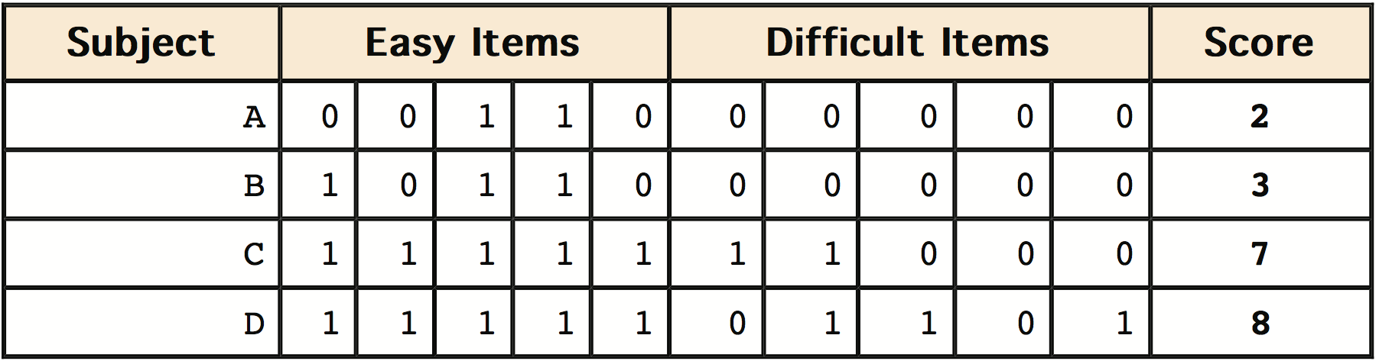
Some Complications
Notes:
Number-of-items recalled is a more complicated case than it appears at first. Consider the following example in which subjects are asked to remember as many items as possible from a list of 10. Assume that (a) there are 5 easy items and 5 difficult items, (b) half of the subjects are able to recall all the easy items and different numbers of difficult items and (c) the other half of the subjects are unable to recall any of the difficult items and remember different numbers of the easy items. Some sample data are shown here.
Let's compare (1) the difference between Subject A's score of 2 and Subject B's score of 3 with (2) the difference between Subject C's score of 7 and Subject D's score of 8. The former difference is a difference of one easy item; the latter difference is a difference of one difficult item. Do these two differences signify the same difference in memory performance? We are inclined to respond “No” to this question since only a little more memory may be needed to retain the additional easy item whereas a lot more memory may be needed to retain the additional hard item. The general point is that it is often inappropriate to consider psychological measurement scales as either interval or ratio.

Slide 73
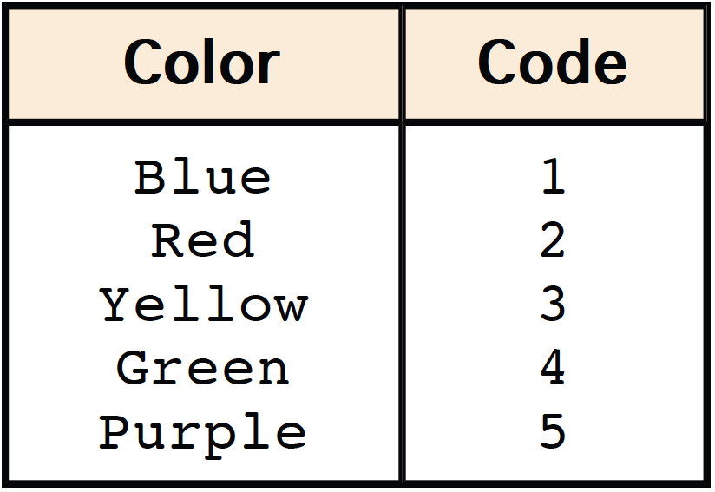
Measurement and Statistics
Notes:
Why are we so interested in the type of scale that measures a dependent variable? The crux of the matter is the relationship between the variable's level of measurement and the statistics that can be meaningfully computed with that variable. For example, consider a hypothetical study in which 5 children are asked to choose their favorite color from blue, red, yellow, green, and purple. The researcher codes and tabulates the results as shown in the displayed table.
This means that if a child said her favorite color was "Red," then the choice was coded as "2," if the child said her favorite color was "Purple" then the response was coded as 5, and so forth.

Slide 74
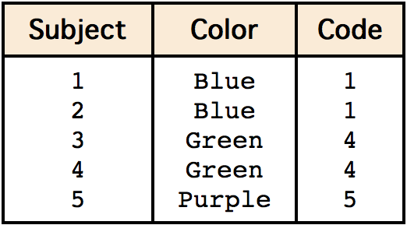
Measurement and Statistics
Is a mean of “3” meaningful?
Notes:
Consider the hypothetical data displayed in this table.
Each code is a number, so nothing prevents us from computing the mean code assigned to the children. The mean happens to be 3, but you can see that it would be senseless to conclude that the average favorite color is yellow (the color with a code of 3). Such nonsense arises because favorite color is a nominal scale, and taking averages of its numerical labels is like counting the number of letters in the name of a snake to see how long the snake is. Does it make sense to compute the mean of numbers measured on an ordinal scale? This is a difficult question, one that statisticians have debated for decades. You will be able to explore this issue yourself in a simulation and reach your own conclusion. The prevailing (but by no means unanimous) opinion of statisticians is that for almost all practical situations, the mean of an ordinally-measured variable is a meaningful statistic. However, as you will see in the simulation, there are extreme situations in which the mean of an ordinally-measured variable can be very misleading.

Slide 75
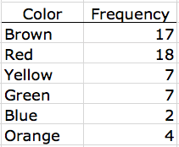

Distributions
Frequency table
Frequency distribution
Notes:
I recently purchased a bag of Plain M&M's. The M&M's were in six different colors. A quick count showed that there were 55 M&M's: 17 brown, 18 red, 7 yellow, 7 green, 2 blue, and 4 orange. These counts are shown in the table.
This table is called a "frequency table" and it describes the distribution of M&M color frequencies. Not surprisingly, this distribution of frequencies is called a frequency distribution.

Slide 76
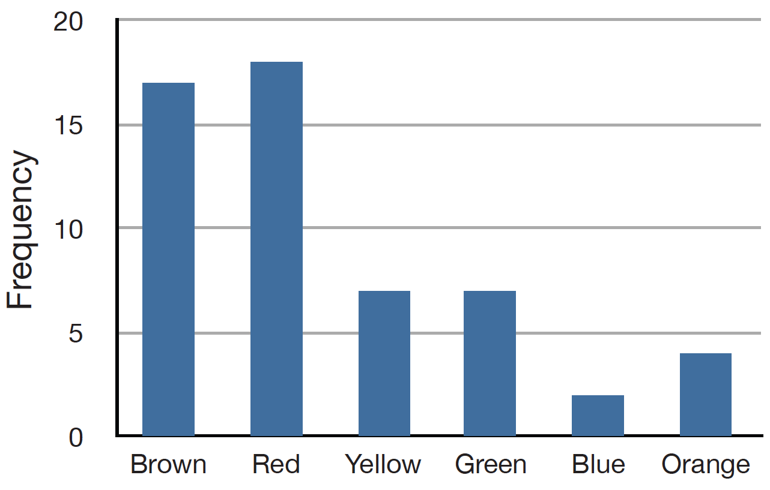
Graph of Frequency Distribution
Notes:
Often a frequency distribution is shown graphically as in this figure.

Slide 77
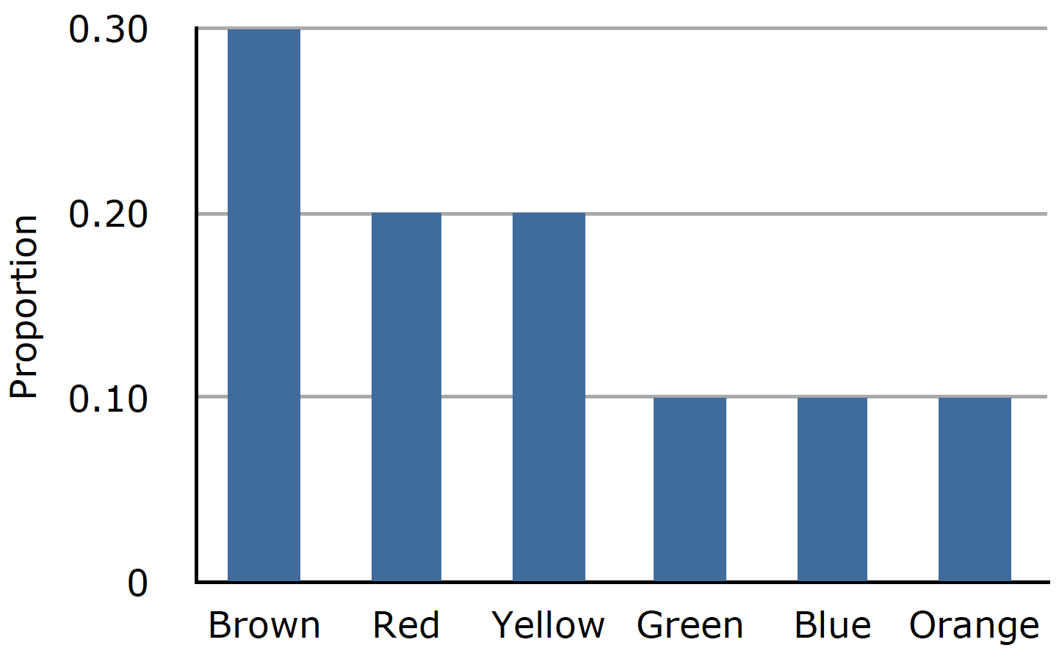
Probability Distribution
Notes:
The distribution on the previous slide is the distribution of the M&M's in one bag. You might be wondering about the distribution of colors for all M&M's. Conveniently, the manufacturer of M&M's provides these data. However, they do not tell us the number of M&M's of each color that they have ever produced. Instead, they report proportions rather than frequencies. This figure shows these proportions. It is called a probability distribution, because if you choose an M&M at random, the probability of getting, say, a brown M&M is equal to the proportion of M&M's that are brown (0.30).

Slide 78
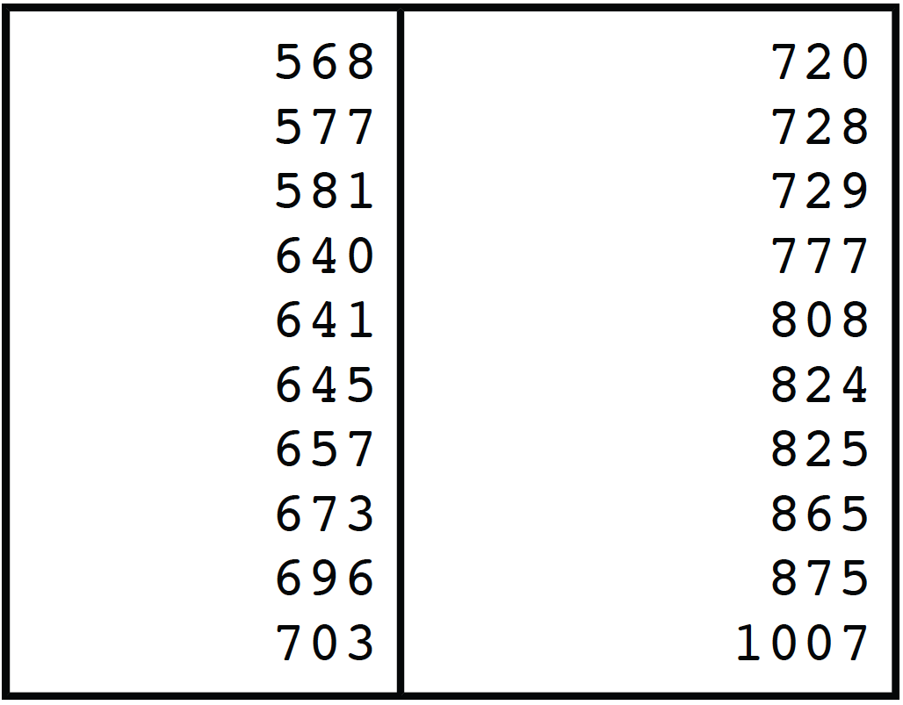
Continuous Variables
Notes:
The data shown here are the times it took one of us to move the mouse over a small target in a series of 20 trials. The times are sorted from lowest to highest. The variable "time to respond" is a continuous variable. With time measured accurately (to many decimal places), no two response times would ever be the same. For the data in the table, time was measured in milliseconds (thousandths of a second) and no two times were the same. Therefore, a frequency distribution would be quite uninformative: it would consist of the 20 times, each with a frequency of 1.

Slide 79
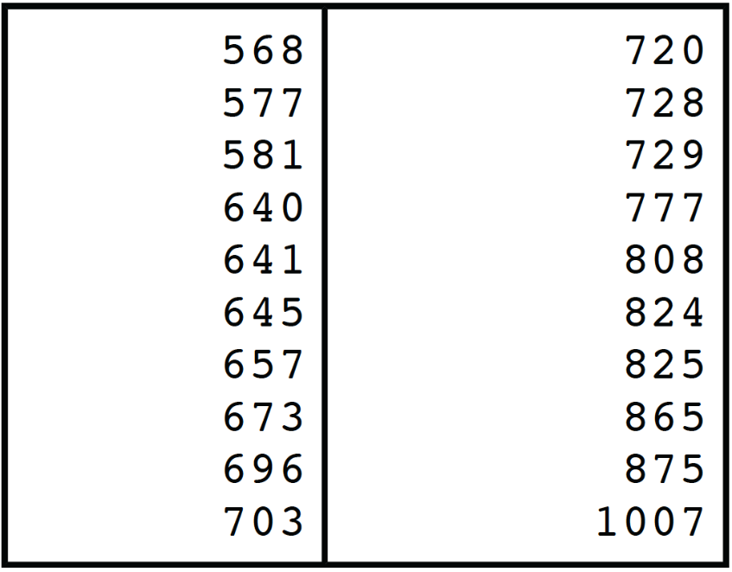
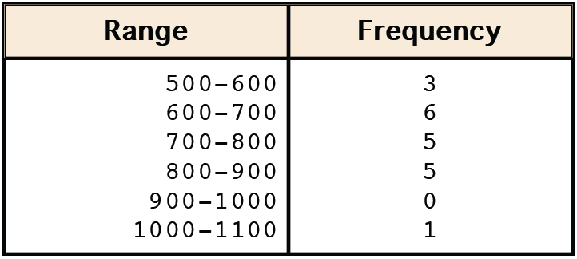
Grouped Frequency Distribution
Notes:
The solution to this problem is to create a grouped frequency distribution. The table shows a grouped frequency distribution for these 20 times. The first group shows the frequency for times between 500 and 600 milliseconds; the second between 600 and 700, and so on. There are several rules of thumb for deciding the number of groups to divide the scores into. This issue is covered in detail in the section on histograms.

Slide 80
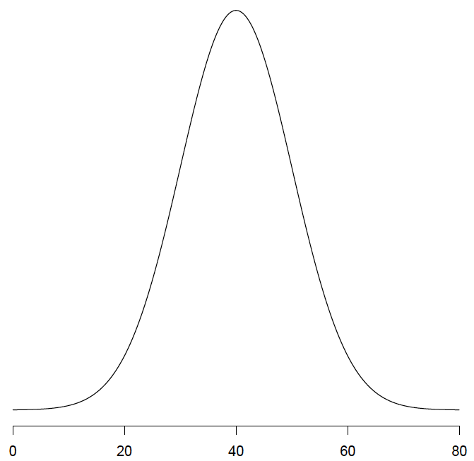
Mathematical Distributions
Notes:
Statisticians have developed mathematical formulas for describing distributions. One you will hear a lot about is the "bell shaped" or normal distribution. Many naturally-occurring phenomena can be approximated very well by a normal distribution. An example of a normal distribution is shown here. The Y axis in the normal distribution represents the probability density; mathematical distributions such as the normal distribution are called probability density functions. As you can see, the distribution is denser in the middle than at the tails. Although this text does not deal with the concept of probability density in any mathematical detail, you should know that (1) the area under the curve is equal to 1, (2) the probability of any exact value of X is 0, and (3) the area between any two points on the X axis is the probability that a number chosen at random will be in that interval.
More information on the normal distribution can be found in a later chapter devoted to normal distributions.

Slide 81
Shapes of Distributions
Normal Distributions vary
Distributions can be asymmetric
Distributions can have more than one peak
Notes:
Distributions have different shapes; they don't all look like the normal distribution. For example, the normal distribution is higher in the middle compared to its two tails. Other distributions need not have this feature. There is even variation among the distributions that we call "normal.” Distributions can also be asymmetric and/or have more than one peak.

Slide 82
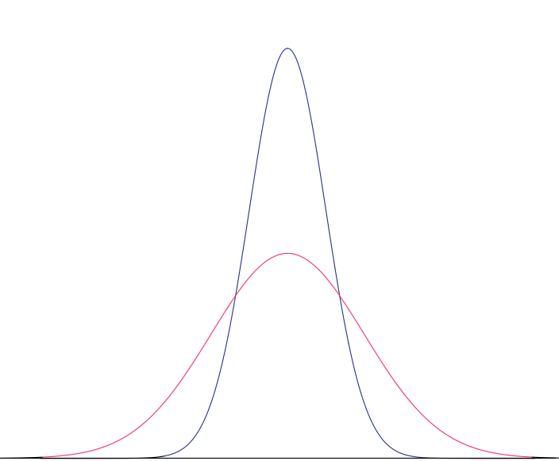
Notes:
This figure shows 2 normal distributions. One property of normal distributions is that they are symmetric; if you folded one in the middle, the two sides would match perfectly. Although these distributions are both normal, they look quite different. The distribution in red is much more spread out than the distribution in blue.

Slide 83
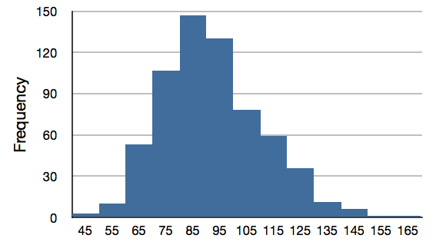
A Skewed Distribution
Notes:
This figure shows the distribution of scores on a psychology test. This distribution is not symmetric: the tail in the positive direction extends further than the tail in the negative direction. A distribution with the longer tail extending in the positive direction is said to have a positive skew. It is also described as "skewed to the right."

Slide 84
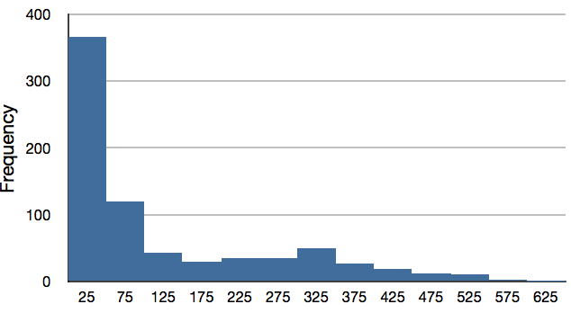
Notes:
Here we see the salaries of major league baseball players in 1974 (in thousands of dollars). This distribution has an extreme positive skew.

Slide 85
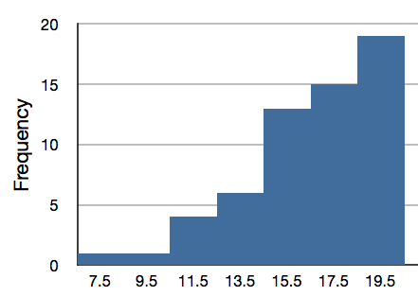
Negative Skew
Notes:
Although less common, some distributions have a negative skew. This figure shows the scores on a 20-point problem on an exam. Each bar represents the frequency of a 2-point range so that the bar on the far left shows the number of students scoring 7 or 8 whereas the bar on the far right shows the number of students scoring 19 or 20. Since the tail of the distribution extends to the left, this distribution is negatively skewed and can also be referred to as "skewed to the left."

Slide 86
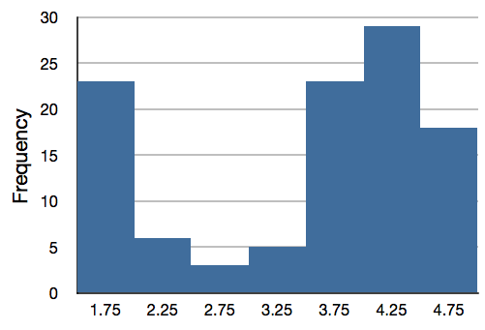
Bimodal Distribution
Notes:
This graph shows the frequencies of times between eruptions of the Old Faithful geyser. The distributions shown up until now have all had one distinct high point or peak. This distribution has two distinct peaks, one at 1.75 and one at 4.25. A distribution with two peaks is called a bimodal distribution.

Slide 87
Summation Notation
2 + 2 = 4
21.16 + 26.01 + 24.01 + 19.37 = 90.54
Notes:
Many statistical formulas involve summing numbers. Fortunately there is a convenient notation for expressing summation. This section covers the basics of this summation notation.

Slide 88
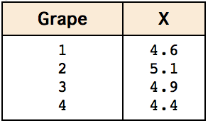

Weights of 4 Grapes
Notes:
Let's say we have a variable X that represents the weights (in grams) of 4 of the grapes shown here.

Slide 89
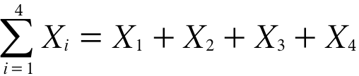
Summing the Values
Grape 1’s weight: X₁
Grape 2’s weight: X₂
Grape 3’s weight: X₃
Grape 4’s weight: X₄
= 4.6 + 5.1 + 4.9 + 4.4
= 19
Notes:
We label Grape 1's weight X sub 1, Grape 2's weight X sub 2, and so on. The sum of the four weights is indicated by the expression shown under the data table. The Greek letter sigma indicates summation. The "i = 1" at the bottom indicates that the summation is to start with X sub 1 and the 4 at the top indicates that the summation will end with X sub 4. The X sub i indicates that X is the variable to be summed as i goes from 1 to 4. Therefore, the symbol means to sum X sub 1 (4.6), X sub 2 (5.1), X sub 3 (4.9), and X sub 4 (4.4). The sum turns out to be 19.0

Slide 90
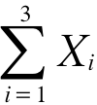
Summing the First 3 Values
4.6 + 5.1 + 4.9
Notes:
This symbol means to sum only the first three values. The index variable i goes from 1 to 3.

Slide 91
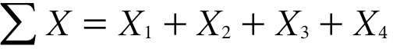
Abbreviated Notation
Notes:
This symbol means to sum all the values of X; when no values of i are shown, it means to sum all the values. It is very convenient to use this abbreviated notation.

Slide 92
Sum of Squares
= 21.16 + 26.01 + 24.01 + 19.37
= 90.54
Notes:
Many formulas involve squaring numbers before they are summed. This symbol means to square each of the values of X and then sum the squared values.

Slide 93
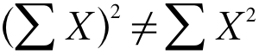
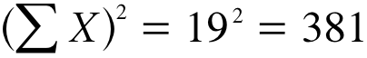
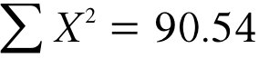
It Makes a Difference
Notes:
It makes a difference whether you sum the values and then square them, or square them and then sum them. The expression on the left of the middle line means to sum up all the values of X and then square the sum (19 squared = 381). The expression on the bottom line means to square the numbers and then sum the squares (90.54, as shown before).

Slide 94
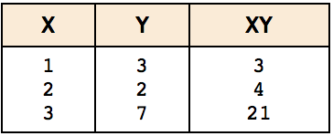
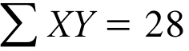
Sum of Cross Products
Notes:
Some formulas involve the sum of cross products. The table shows the data for variables X and Y. The cross products (XY) are shown in the third column. The sum of the cross products is 28. The formula at the bottom shows how to express this in summation notation.

Slide 95
Linear Transformations
Used to change from one measurement scale to another
Involves multiplying by a constant and then adding a second constant
Notes:
Often it is necessary to transform data from one measurement scale to another. For example, you might want to convert height measured in feet to height measured in inches. Linear transformations involve multiplying a variable by a constant and then adding a second constant.

Slide 96
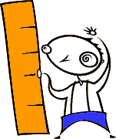
Converting Between Feet and Inches
Inches = Feet x 12 Inches/feet
Notes:
This table shows the heights of five people measured in both feet and inches. To transform feet to inches, you multiply the number of feet by 12. For example, 5 feet times 12 inches per foot equals 60 inches.

Slide 97
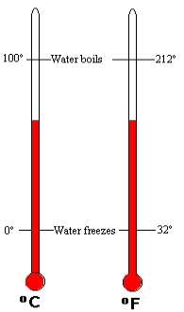
Other Conversions
Converting from Fahrenheit to Celsius
Notes:
Some conversions require that you multiply by a number and then add a second number. For instance, the transformation between degrees Centigrade and degrees Fahrenheit requires that you multiply by a number and then add a second number.

Slide 98


Converting from Centigrade to Fahrenheit
Centigrade to Fahrenheit
F = 1.8C + 32
Notes:
For the conversion from Centigrade to Fahrenheit, the first constant (or the number you multiply by) is 1.8 and the second constant (or the number you add) is 32. So, to convert from Centigrade to Fahrenheit, you multiply degrees Centigrade by 1.8 and then you add 32.

Slide 99
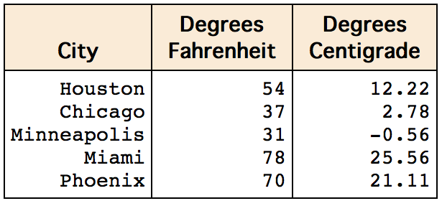
Temperature in 5 Cities
Notes:
This table shows the temperatures of 5 US cities in the early afternoon of November 16, 2002. The temperatures are given in both Fahrenheit and Celsius.

Slide 100
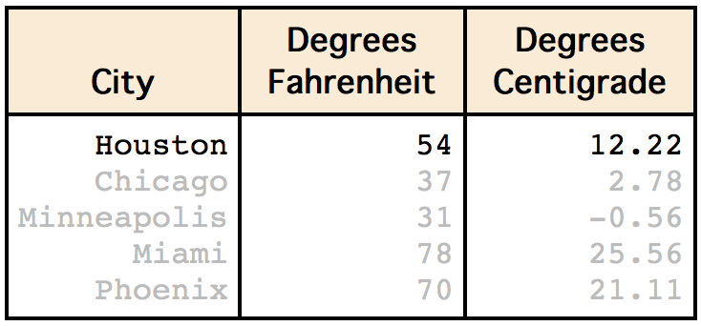
Temperature in 5 Cities
Centigrade to Fahrenheit
F = 1.8 (12.22) + 32 F = 22 + 32 F = 54
Notes:
To convert Houston's temperature in Celsius to Fahrenheit, multiply Houston's temperature in Celsius (12.22) by 1.8 and then add 32. This equals 54.

Slide 101
Linear Transformation
Notes:
Here you see a plot of degrees Centigrade as a function of degrees Fahrenheit. Notice that the points form a straight line. This will always be the case if the transformation from one scale to another consists of multiplying by one constant and then adding a second constant keeping in mind that the second constant may be zero. These types of transformations are therefore called linear transformations.

Slide 102
Formal Definition
If a variable Y is created from variable X using the formula: Y = bX + A where b and A are constants, then Y is a linear transformation of X.
F = 1.8C + 32
Notes:
If a new variable Y is created from variable X using the formula Y = bX + A where b and A are constants, then Y is a linear transformation of X. In the temperature example, Y is degrees Fahrenheit, X is degrees Centigrade, b = 1.8 and A = 32.

Slide 103
Some Nonlinear Transformations
Square root
Power
Log
Cosine
Notes:
Many transformations are not linear. With nonlinear transformation, the points in a plot of the transformed variable against the original variable would not fall on a straight line. Examples of nonlinear transformations are: square root, raising to a power, logarithm, and any of the trigonometric functions.

Slide 104
Other Announcements
Graphing Distributions

Slide 105

iMac Introduced in 1998
Was the iMac attracting only previous Macintosh owners?
Was it attracting new computer users?
Was it attracting Windows users?
Notes:
When Apple Computer introduced the iMac computer in August 1988, the company wanted to learn whether the iMac was expanding Apple’s market share. Was the iMac just attracting previous Macintosh owners? Or was it purchased by newcomers to the computer market, and by previous Windows users who were switching over?

Slide 106
Qualitative Variables
No ordering
Example: the three categories of iMac purchasers
This contrasts with quantitative data such as a person’s weight.
Notes:
To find out, 500 iMac customers were interviewed. Each customer was categorized as a previous Macintosh owners, a previous Windows owner, or a new computer purchaser. This section examines graphical methods for displaying the results of the interviews. We’ll learn some general lessons about how to graph data that fall into a small number of categories. The key point about the qualitative data that occupy us in the present section is that they do not come with a pre-established ordering (the way numbers are ordered). For example, there is no natural sense in which the category of previous Windows users comes before or after the category of previous iMac users.

Slide 107
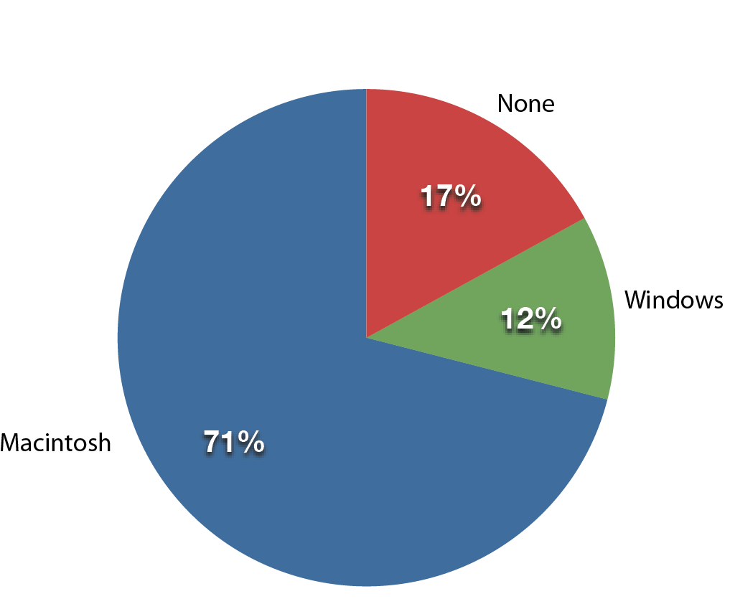
Pie Charts
Each slice is proportional to the percentage of choices in the category.
Notes:
The pie chart in the figure shows the results of the iMac study. In a pie chart, each category is represented by a slice of the pie. The area of the slice is proportional to the percentage of responses in the category. Although most iMac purchasers were Macintosh owners, Apple was encouraged by the 12% of purchasers who were former Windows users, and by the 17% of purchasers who were buying a computer for the first time.

Slide 108
Pie Charts Problems
Not recommended when there are many categories
Not recommended for comparing two survey instruments
“The only worse design than a pie chart is several of them.” (Edward Tufte)
Notes:
Pie charts are effective for displaying the relative frequencies of a small number of categories. They are not recommended, however, when you have a large number of categories. Pie charts can also be confusing when they are used to compare the outcomes of two different surveys or experiments. In an influential book on the use of graphs, Edward Tufte asserted "The only worse design than a pie chart is several of them."

Slide 109
Small Number of Observations
Can be misleading to give percentages
Unless there are many observations, it is better to give actual frequencies.
Notes:
Here is another important point about pie charts. If a pie chart is based on a small number of observations, it can be misleading to label the pie slices with percentages. For example, if just 5 people had been interviewed by Apple Computers, and 3 were former Windows users, it would be misleading to display a pie chart with the Windows slice showing 60%. With so few people interviewed, such a large percentage of Windows users might easily have occurred since chance can cause large errors with small samples. In this case, it is better to alert the user of the pie chart to the actual numbers involved. The slices should therefore be labeled with the actual frequencies observed (e.g., 3) instead of with percentages.

Slide 110
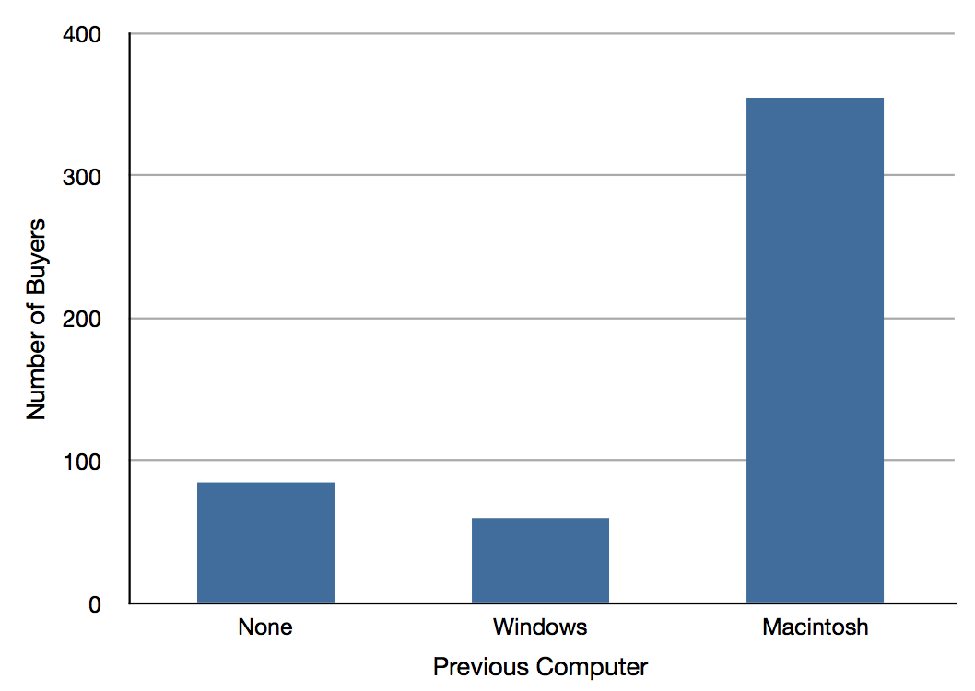
Bar Charts
Notes:
Bar charts can also be used to represent frequencies of different categories. A bar chart of the iMac purchases is shown here. Frequencies are shown on the Y axis and the type of computer previously owned is shown on the X axis. Typically the Y-axis shows the number of observations rather than the percentage of observations in each category as is typical in pie charts.

Slide 111
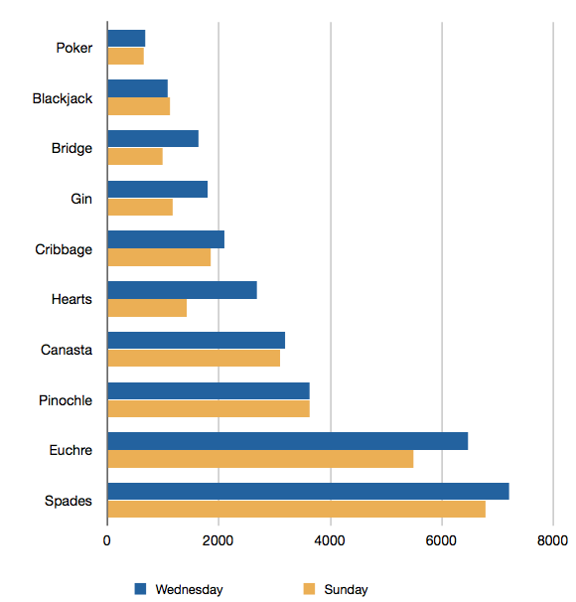
Comparing Distributions
Notes:
Often we wish to compare the results of different surveys, or of different conditions within the same overall survey. In this case, we are comparing the "distributions" of responses between the surveys or conditions. Bar charts are often excellent for illustrating differences between two distributions. This figure shows the number of people playing card games at the Yahoo website on a Sunday and on a Wednesday. We see that there were more players overall on Wednesday than on Sunday. The number of people playing Pinochle was nonetheless the same on these two days. In contrast, there were about twice as many people playing hearts on Wednesday as on Sunday. Facts like these emerge clearly from a well-designed bar chart.

Slide 112
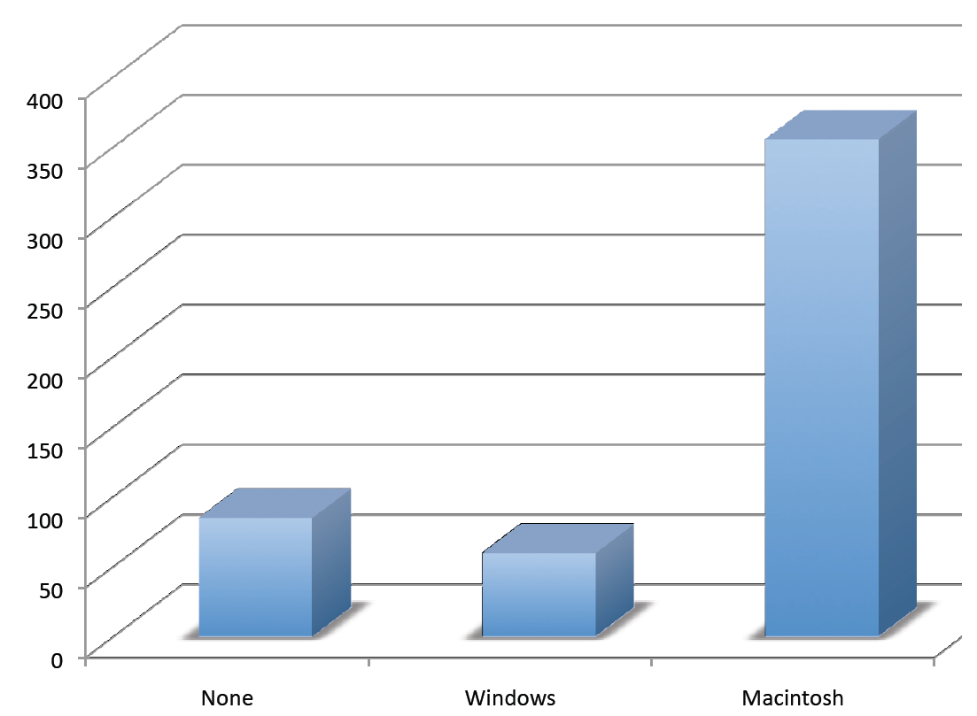
Three Dimensional Bar Chars
Notes:
Don’t get fancy! People sometimes add features to graphs that don’t help to convey their information. For example, 3-dimensional bar charts like the one shown in the figure are usually not as effective as their two-dimensional counterparts.

Slide 113
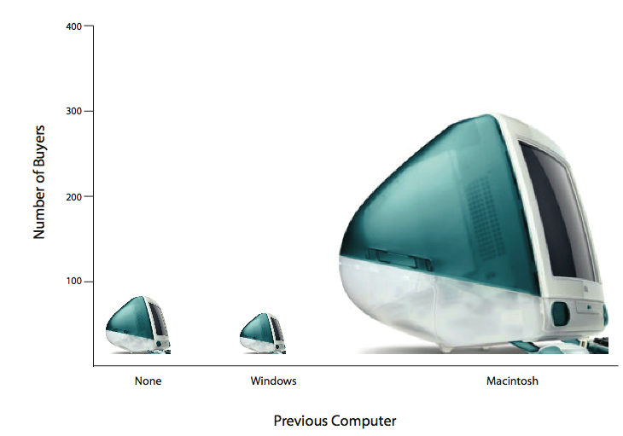
The Lie Factor
Notes:
Here is another way that fanciness can lead to trouble. Instead of plain bars, it is tempting to substitute meaningful images. For example, this figure presents the iMac data using pictures of computers. The heights of the pictures accurately represent the number of buyers, yet the figure is misleading because the viewer's attention will be captured by areas. This can exaggerate the size differences between the groups. In terms of percentages, the ratio of previous Macintosh owners to previous Windows owners is about 6 to 1. But the ratio of the two areas in this figure is about 35 to 1. A biased person wishing to hide the fact that many Windows owners purchased iMacs would be tempted to use this figure rather than the simple bar chart! Edward Tufte coined the term "lie factor" to refer to the ratio of the size of the effect shown in a graph to the size of the effect shown in the data. He suggests that lie factors greater than 1.05 or less than 0.95 produce unacceptable distortion.

Slide 114
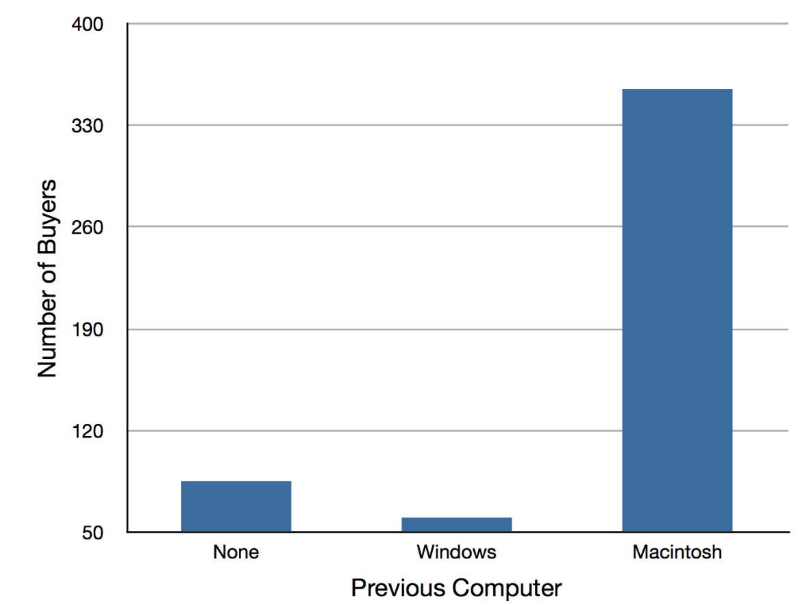
Misleading Baselines
Notes:
Another distortion in bar charts results from setting the baseline to a value other than zero. The baseline is the bottom of the Y-axis, representing the least number of cases that could have occurred in a category. Normally, this number should be zero. This figure shows the iMac data with a baseline of 50. Once again, the difference in areas suggests a different story than the true differences in percentages. The number of Windows-switchers seems miniscule compared to its true value of 12%.

Slide 115
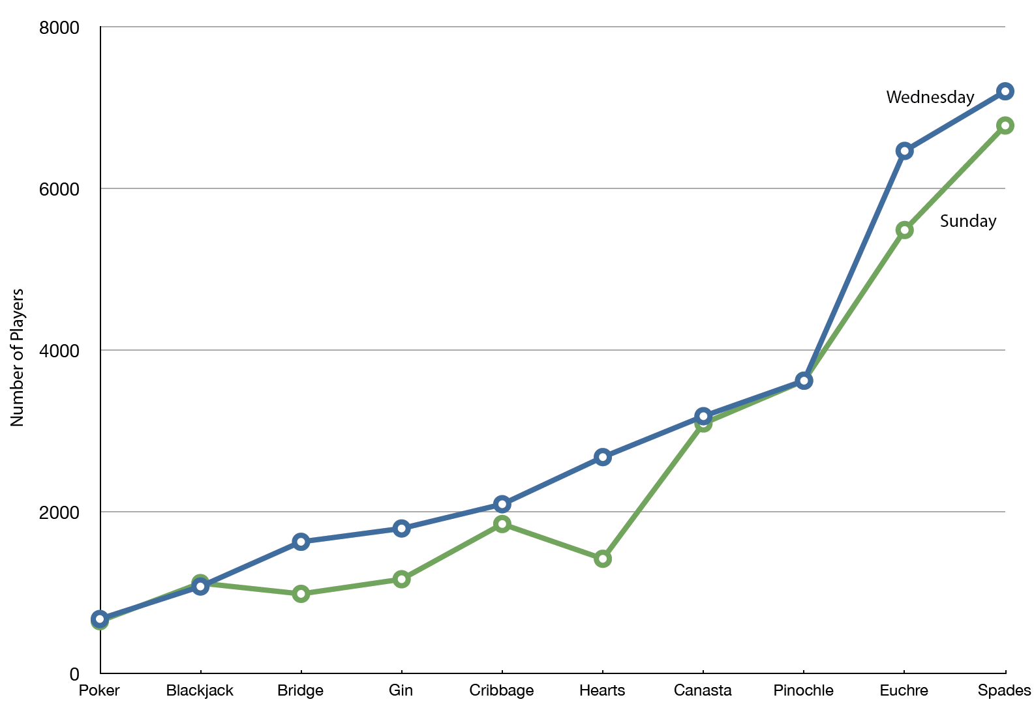
Avoid Line Graphs with Qualitative Data
Notes:
Finally, note that it is a serious mistake to use a line graph when the X-axis contains merely qualitative variables. A line graph is essentially a bar graph with the tops of the bars represented by points joined by lines (the rest of the bar is suppressed). This figure inappropriately shows a line graph of the card game data from Yahoo. The drawback to this figure is that it gives the false impression that the games are naturally ordered in a numerical way.

Slide 116
Summary
Pie charts and bar charts can both be effective methods for displaying qualitative data
Bar charts are better when there are more than just a few categories
Avoid creating misleading graphs
Notes:
To summarize, Pie charts and bar charts can both be effective methods for displaying qualitative data. Bar charts are better when there are more than just a few categories. Avoid creating misleading graphs

Slide 117

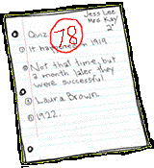

Quantitative Variables
Numeric Scale
Notes:
Quantitative variables are variables measured on a numeric scale. Height, weight, temperature, and scores on an exam are all examples of quantitative variables.

Slide 118
Quantitative versus Qualitative
Quantitative | Qualitative
Measured on numeric scale Height Weight Temperature Scores on an exam | No ordering or measuring Favorite color Religion City of Birth Favorite Sport
Notes:
Quantitative variables are distinguished from categorical variables such as favorite color, religion, city of birth, and favorite sport in which there is no ordering or measuring involved. Categorical variables are sometimes called “qualitative variables.”

Slide 119
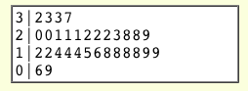
Graphing Quantitative Variables
Notes:
There are many types of graphs that can be used to portray distributions of quantitative variables and the upcoming sections cover several of these. Some graph types, like this stem and leaf graph, are best-suited for small to moderate amounts of data …

Slide 120
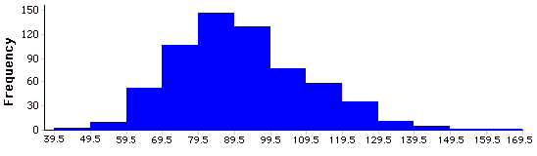
Graphing Quantitative Variables
Notes:
… whereas others, like this histogram, are best-suited for large amounts of data.

Slide 121
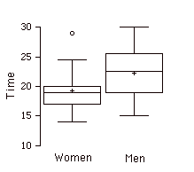
Graphing Quantitative Variables
Notes:
Some types of graphs are good at summarizing differences between distributions. These two box plots compare the time to complete a task for men and women…

Slide 122
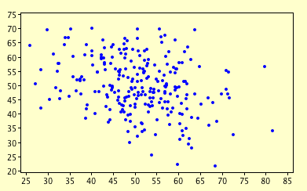
Graphing Quantitative Variables
Notes:
while others, like this scatter plot, are used to show the relationship between variables.

Slide 123
Stem and Leaf Displays
Graphical method for displaying data
Particularly useful for small datasets
Notes:
A stem and leaf display is a graphical method of displaying data. It is particularly useful when your data are not too numerous. In this section, we will explain how to construct and interpret this kind of graph.

Slide 124
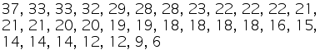
Example
Notes:
As usual, an example will get us started. The top of the display shows the number of touchdown passes thrown by each of the 31 teams in the National Football League in the 2000 season. A stem and leaf display of the data is shown below.

Slide 125
Stems and Leaves
Stems
Leaves
Notes:
The left portion of the stem and leaf display contains the stems. They are the numbers 3, 2, 1, and 0, arranged as a column to the left of the bars. Think of these numbers as 10’s digits. A stem of 3 (for example) can be used to represent the 10’s digit in any of the numbers from 30 to 39. The numbers to the right of the bar are leaves, and they represent the 1’s digits. Every leaf in the graph therefore stands for the result of adding the leaf to 10 times its stem.

Slide 126
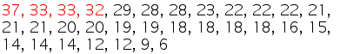
Row 1
Notes:
To make this clear, let us examine the display more closely. In the top row, the four leaves to the right of stem 3 are 2, 3, 3, and 7. Combined with the stem of 3, these leaves represent the numbers 32, 33, 33, and 37, which are the numbers of TD passes for the first four teams.

Slide 127
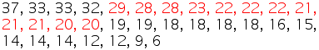
Row 2
Notes:
The second row has a stem of 2 and contains 12 leaves. Together, they represent 12 data points, namely, two occurrences of 20 touchdown passes, three occurrences of 21 touchdown passes, three occurrences of 22 touchdown passes, one occurrence of 23 touchdown passes, two occurrences of 28 touchdown passes, and one occurrence of 29 touchdown passes. I will leave it to you to figure out what the third row represents. The fourth row has a stem of 0 and two leaves. It stands for the last two entries in the data; namely 9 touchdown passes and 6 touchdown passes. (The latter two numbers may be thought of as 09 and 06.).

Slide 128
Shape of the Distribution
Notes:
One purpose of a stem and leaf display is to clarify the shape of the distribution. You can see many facts about touchdown passes more easily in the stem and leaf display than from the raw numbers. For example, by looking at the stems and the shape of the plot, you can tell that most of the teams had between 10 and 29 passing touchdowns, with a few having more and a few having less. The precise numbers of touchdown passes can be determined by examining the leaves.

Slide 129
Splitting Stems
Notes:
We can make our figure even more revealing by splitting each stem into two parts. The display on the right shows how to do this. The top row is reserved for numbers from 35 to 39 and holds only the 37 touchdown passes. The second row is reserved for the numbers from 30 to 34 and holds the 32, 33, and 33 touchdown passes made by the next three teams.. You can see for yourself what the other rows represent.
The figure on the right is more revealing than the figure on the left because the latter figure lumps too many values into a single row. Whether you should split stems in a display depends on the exact form of your data. If rows get too long with single stems, you might try splitting them into two or more parts.

Slide 130
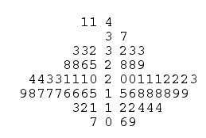
Comparing Distributions
1998
2000
Stems
Notes:
There is a variation of stem and leaf displays that is useful for comparing distributions. The two distributions are placed back to back along a common column of stems. The result is a “back to back stem and leaf graph.” Here you see such a graph. It compares the numbers of touchdown passes in the 1998 and 2000 seasons. The stems are in the middle, the leaves to the left are for the 1998 data, and the leaves to the right are for the 2000 data. For example, the second-to-last row shows that in 1998 there were teams with 11, 12, and 13 touchdown passes, and in 2000 there were two teams with 12 and three teams with 14 touchdown passes.

Slide 131
Why these Graphs were Easy
Numbers are whole numbers
All numbers are positive
Notes:
There are two things about the football data that make them easy to graph with stems and leaves. First, the data are limited to whole numbers that can be represented with a one-digit stem and a one-digit leaf. Second, all the numbers are positive. If the data include numbers with three or more digits, or contain decimals, they can be rounded to two-digit accuracy.

Slide 132
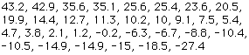
Example with Negative Numbers
Does a preceding “weapon” word speed up the pronunciation of an aggressive word?
Example: Time to name “Punch” when preceded by “Bug” minus time to name “Punch” when preceded by “Gun.”
Notes:
The data shown here are from a study on aggressive thinking. Each value is the mean difference over a series of trials between the time it took an experimental subject to name aggressive words (like “punch”) under two conditions. In one condition the words were preceded by a non-weapon word such as "bug." In the second condition, the same words were preceded by a weapon word such as "gun" or "knife." The issue addressed by the experiment was whether a preceding weapon word would speed up (or prime) pronunciation of the aggressive word, compared to a non-weapon priming word. A positive difference implies greater priming of the aggressive word by the weapon word. Negative differences imply that the priming by the weapon word was less than for a neutral word.
You see that the numbers range from 43.2 to -27.4. The first value indicates that one subject was 43.2 milliseconds faster pronouncing aggressive words when they were preceded by weapon words than when preceded by neutral words. The value -27.4 indicates that another subject was 27.4 milliseconds slower pronouncing aggressive words when they were preceded by weapon words.

Slide 133
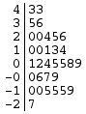
Negative Numbers and Rounding
Numbers are rounded to whole numbers.
Negative stems are included.
Notes:
The data are displayed with stems and leaves in the lower right. Since stem and leaf displays can only portray two whole digits (one for the stem and one for the leaf) the numbers are first rounded. Thus, the value 43.2 is rounded to 43 and represented with a stem of 4 and a leaf of 3. Similarly, 42.9 is rounded to 43. To represent negative numbers, we simply use negative stems. For example, the bottom row of the figure represents the number –27. The second-to-last row represents the numbers –10, -10, -15, etc.
Observe that the figure contains a row headed by "0" and another headed by"-0". The stem of 0 is for numbers between 0 and 9 whereas the stem of –0 is for numbers between 0 and –9. For example, the fifth row of the table holds the numbers 1, 2, 4, 5, 5, 8, 9 and the sixth row holds 0, -6, -7, and -9. Values that are exactly 0 before rounding should be split as evenly as possible between the "0" and "-0" rows.

Slide 134
Large Values and Large Datasets
Notes:
Although stem and leaf displays are unwieldy for large datasets, they are often useful for datasets with up to 200 observations. This stem and leaf display portrays the distribution of populations of 185 US cities in 1998. To be included, a city had to have between 100,000 and 500,000 residents.
Since a stem and leaf plot shows only two-place accuracy, we had to round the numbers to the nearest 10,000. For example the largest number (493,559) was rounded to 490,000 and then plotted with a stem of 4 and a leaf of 9. The fourth highest number (463,201) was rounded to 460,000 and plotted with a stem of 4 and a leaf of 6. Thus, the stems represent units of 100,000 and the leaves represent units of 10,000. Notice that each stem value is split into five parts: 0-1, 2-3, 4-5, 6-7, and 8-9.

Slide 135
Summary
Suitability of a stem and leaf display depends on whether the data can be rounded without loss of important information.
Statistics is not just recipes.
Notes:
Whether your data can be suitably represented by a stem and leaf graph depends on whether they can be rounded without loss of important information. Also, their extreme values must fit into two successive digits, as the previous data fit into the 10,000 and 100,000 places (for leaves and stems, respectively). Deciding what kind of graph is best suited to displaying your data thus requires good judgment. Statistics is not just recipes!

Slide 136
Histograms
Graphical method for displaying the shape of a distribution
Especially useful with a large number of observations
Notes:
A histogram is a graphical method for displaying the shape of a distribution. It is particularly useful when there are a large number of observations.

Slide 137
Psychology Test Example
Example: Psychology test with 642 students
197 test items
Each item was graded as correct or incorrect
The scores ranged from 46 to 167
Notes:
To illustrate, we will create a histogram based on the scores of 642 students on a psychology test. The test consists of 197 items each graded as "correct" or "incorrect." The students’ scores ranged from 46 to 167.

Slide 138
First Steps
Create a frequency table
Group scores together
Notes:
The first step is to create a frequency table. Unfortunately, a simple frequency table would be too big, containing over 100 rows. To simplify our task, we group scores together as shown in the next Table.

Slide 139

A Histogram
Notes:
We changed the frequency counts into bars of various heights, and here’s the resulting histogram. The first interval extends from 39.5 to 49.5 and includes three scores. The interval with the most scores (147) extends from 79.5 to 89.5. Importantly, the height of the graph at each interval corresponds to the number of scores in it.
This histogram makes it plain that most of the scores are in the middle of the distribution, with fewer scores in the extremes. You can also see that the distribution is not symmetric, in that the scores extend to the right farther than they do on the left. The distribution is therefore said to have a positive skew.

Slide 140
Continuous Variables
Can be used with whole numbers
Can be used with a continuous scale
Then use whole numbers as boundaries for class intervals
Notes:
In our previous example, the observations are whole numbers. Histograms can also be used when the scores are measured on a more continuous scale such as the length of time (in thousandths of a second) required to perform a task. In this case, there is no need to worry about values falling on the class boundaries. (It would be quite a coincidence for a task to require exactly 7 seconds, measured to the nearest thousandth of a second.) We are therefore free to choose whole numbers as boundaries for our class intervals, for example, 4000, 5000, etc. The class frequency is then the number of observations that are greater than or equal to the lower bound, and strictly less than the upper bound. For example, one interval might hold times from 4000 to 4999 milliseconds. Using whole numbers as boundaries avoids a cluttered appearance, and is the practice of many computer programs that create histograms. Note also that some computer programs label the middle of each interval rather than the end points.

Slide 141
Relative Frequencies
Can be relative frequencies instead of actual frequencies
Show the proportion of scores in each interval
The Y-axis runs from 0 to 1
To change from frequencies to relative frequencies:
Divide each class frequency by the total number of observations
Plot the quotients on the Y axis (labeled as proportions)
Notes:
Histograms can be based on relative frequencies instead of actual frequencies. Histograms based on relative frequencies show the proportion of scores in each interval rather than the number of scores. In this case, the Y axis runs from 0 to at most 1. You can change a histogram based on frequencies to a histogram based on relative frequencies by (a) dividing each class frequency by the total number of observations, and then (b) plotting the quotients on the Y axis (labeled as proportions).

Slide 142
Summary of Steps
Calculate the range of scores (highest minus lowest)
Create class intervals
Count the scores in each interval
Represent the frequencies with bars
Notes:
To summarize the steps in constructing a histogram, you first calculate the range of scores by subtracting the smallest observation from the largest; the range of scores is then broken into intervals, called class intervals. Next, the number of scores falling into each interval is counted (or tallied) to obtain the class frequencies. Finally, the class frequencies are represented by bars.

Slide 143
A Second Example
Notes:
Let’s look at another example. Since this example has only 20 numbers, it is easier to see the relationship between frequency and height of the bars in the histogram. The data shown in this table are the times it took one of us to move a computer mouse over a small target in a series of 20 trials. The times are sorted from lowest to highest. The variable "time to respond" is a continuous variable. With time measured accurately (to many decimal places), no two response times would be expected to be the same. As you can see from this table, no two were the same. As a result, an ungrouped frequency distribution would be uninformative: it would consist of the 20 times, each with a frequency of 1.

Slide 144
Frequency Distribution
Notes:
To understand the relationship between frequency and the height of bars in a histogram, place one tally mark in the appropriate row for each frequency. Notice that the class interval with the highest frequency (600-700) has the highest tally height (6).

Slide 145
Rotate the Tally
Notes:
Then, if you rotate this table on its side, you can see a figure that is beginning to look like a histogram.

Slide 146
Another Histogram
Notes:
Finally, if you replace the tally marks with thick bars, you have a completed histogram. Notice that the highest frequency (600-700) has the highest bar (just like it had the most tally marks).

Slide 147
Frequency Polygons
Graphical device for understanding shapes of distributions.
Especially helpful in comparing distributions.
Good for displaying cumulative frequency distributions.
Notes:
Frequency polygons are a graphical device for communicating the shapes of distributions. They serve the same purpose as histograms, but are especially helpful in comparing distributions. Frequency polygons are also a good choice for displaying cumulative frequency distributions.

Slide 148
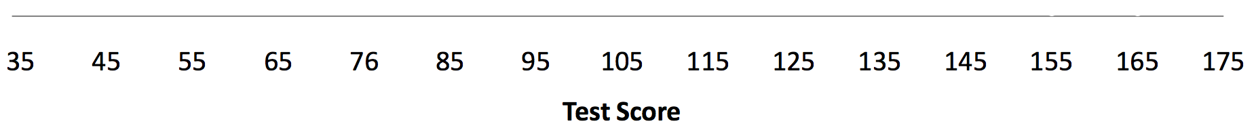
Choose Class Intervals
Start by:
Choosing a class interval
Drawing an X-axis
Labeling the middle of each class interval
Notes:
To create a frequency polygon, start just as for histograms, by choosing a class interval. Then draw an X-axis representing the values of the scores in your data. As an example, we are going to create a frequency distribution for the scores on a psychology test (this is the same dataset from the histogram section). We choose a class interval of 10. Our first interval extends from 29.5 to 39.5 and has a midpoint of 35. Note that this interval does not contain any test scores. Neither does the highest interval which extends from 169.5 to 179.5. We choose first and last intervals that do not contain any test scores so the line will touch the x-axis.

Slide 149
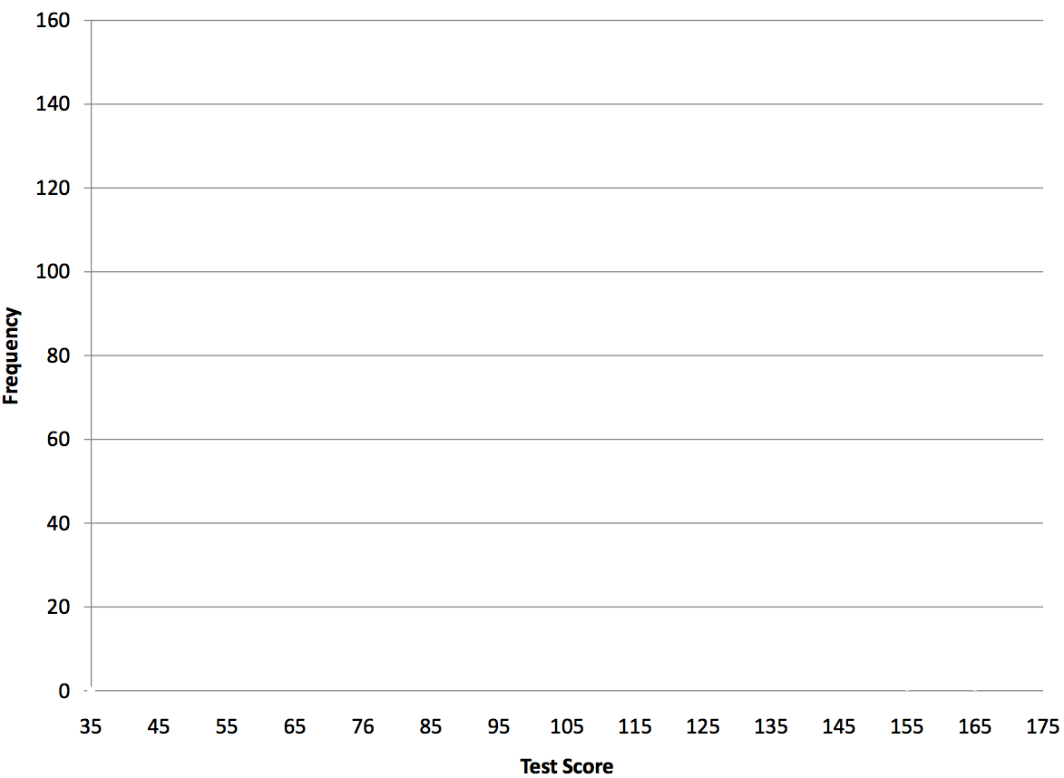
Draw Axes
Notes:
Draw the Y-axis to indicate the frequency of each class.

Slide 150
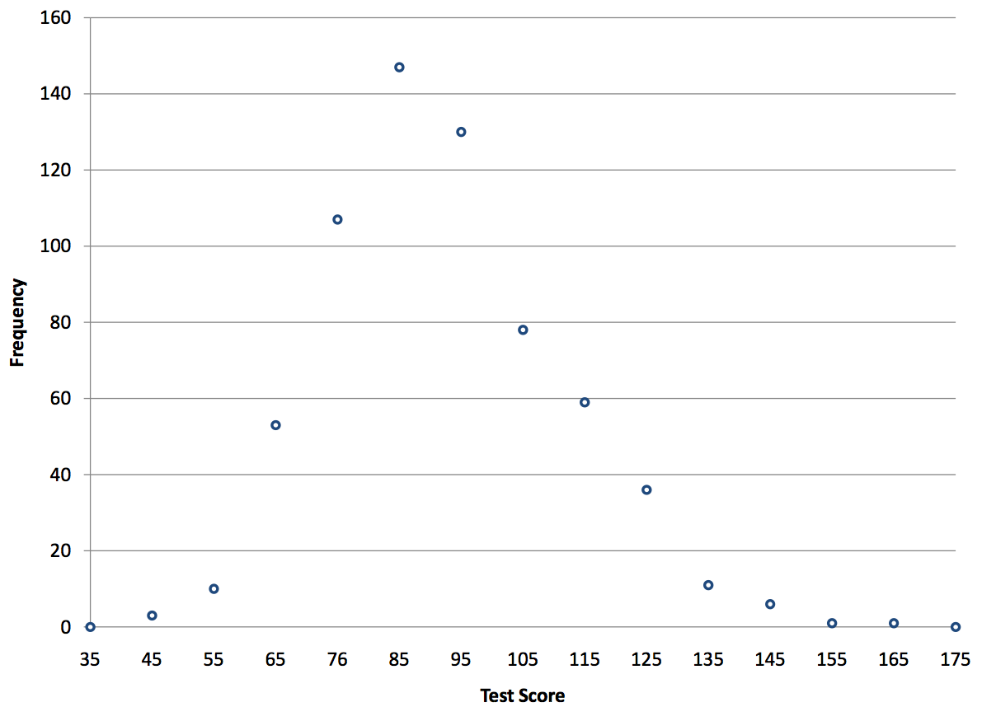
Frequency Polygons
Notes:
Next, we are going to use the data from the frequency table to place a point in the middle of each class interval at the height corresponding to its class frequency. The graph does not show the upper or lower limits of the intervals.

Slide 151

Frequency Polygons
Notes:
Finally, connect the points. Note that there is one class interval below the lowest value in your data and one above the highest value. As a result, the graph touches the X-axis on both sides.

Slide 152
Frequency Polygons
Notes:
You can easily see the shape of the distribution from this figure. Most of the scores are between 65 and 115. It is clear that the distribution is not symmetric inasmuch as good scores (to the right) trail off more gradually than poor scores (to the left). That is, the tail is longer to the right than it is to the left. This kind of distribution is called a distribution with a positive skew. It is also called “skewed to the right.”

Slide 153

Notes:
A cumulative frequency distribution shows the cumulative frequency for each class interval. The first interval has frequency and cumulative frequency of 0. The frequency of the second interval is 3. The cumulative frequency is the the sum of the frequencies of all intervals up to and including the one in question. The third interval has frequency of 10. Its cumulative frequency is 0 + 3 + 10 = 13.

Slide 154

Cumulative Frequency
Notes:
A cumulative frequency polygon for the same test scores is shown here. The graph is the same as for a frequency polygon except that the Y value for each point is the cumulative frequency rather than the frequency. For example, there are no scores in the interval labeled "35," three in the interval "45,"and 10 in the interval "55. "Therefore the cumulative frequency for "55" is 0 + 3 + 10 =13. Since 642 students took the test, the cumulative frequency for the last interval is 642.

Slide 155

Two Frequency Polygons
Notes:
Frequency polygons are especially useful for comparing distributions. This is achieved by overlaying the frequency polygons drawn for different data sets. This figure provides an example. The data come from a task in which the goal is to move a computer cursor to a target on the screen as fast as possible. On 20 of the trials, the target was a small rectangle; on the other 20, the target was a large rectangle. Time to reach the target was recorded on each trial. The two distributions (one for each target) are plotted together. The figure shows that although there is some overlap in times, it generally took longer to move the cursor to the small target than to the large one.

Slide 156

Cumulative Frequencies
Notes:
It is also informative to plot two cumulative frequency distributions in the same graph. This is illustrated here using the same data from the movement task. The difference in distributions for the two targets is again clearly evident.

Slide 157
Box Plots
Method for visually representing data
Useful for identifying extreme values
Useful for comparing distributions
Notes:
We have already discussed techniques for visually representing data such as histograms and frequency polygons. In this section we present another important method, called box plots. Box plots are useful for identifying extreme values called outliers and for summarizing and comparing distributions.

Slide 158
Box Plots
Example: Experiment naming 30 rectangles
30 colored rectangles
Name the color as quickly as possible
Times were recorded
Notes:
We will explain box plots with the help of data from an in-class experiment. Students in Introductory Statistics were presented with a page containing 30 colored rectangles. Their task was to name the colors as quickly as possible, and their times were recorded.

Slide 159
Rectangles from experiment
Notes:
Here’s a example of the colored rectangles that the Introductory Statistics students viewed and named as quickly as possible.

Slide 160
Experiment
16 men and 31 women participated
Two boxplots were created, one for each gender
Notes:
We'll compare the scores for the 16 men and 31 women who participated in the experiment by making separate box plots for each gender. (Such a display is said to involve parallel box plots.)

Slide 161

Drawing Percentiles
Notes:
There are several steps in constructing a box plot. First we draw the Y-axis

Slide 162

Drawing Percentiles
75th Percentiles
25th Percentiles
Notes:
Then we draw lines representing the 25th and 75th percentiles for each gender. Thus for each gender, the lower line is the 25th percentile and the upper line is the 75th percentile. For the women, the 25th percentile is 17 and the 75th is 20. For the men, the 25th percentile is 19 and the 75th is 25.75. We can see already that it took men longer than women to name the colors since both percentiles are higher for the men than for the women.

Slide 163

Making the Boxes
Notes:
The next step is to connect the lines forming boxes for each gender.

Slide 164

Adding the Medians
Notes:
Now we draw a line showing the median for each group. Naturally the median is between the 25th and 75th percentiles. The median time is 19.5 for the women and 22.5 for the men.

Slide 165

Terminology
The upper hinge is the 75th percentile.
The lower hinge in the 25th percentile.
The H-spread is the difference between the upper and lower hinges.
Notes:
Some terminology is helpful for explaining more about boxplots.
The upper hinge is the 75th percentile.
The lower hinge is the 25th percentile.
The H-spread is the difference between the upper and lower hinges.
For the women’s data, the upper hinge is 20, the lower hinge is 17 and the H-spread is 20 - 17 = 3.

Slide 166

More Terminology
A step is 1.5 times the H-spread.
There are two inner fences. The upper inner fence is one step above the upper hinge; the lower one is one step below the lower hinge.
Notes:
Here we have three more important terms.
A step is 1.5 times the H-spread.
There are two inner fences. The upper inner fence is one step above the upper hinge; the lower inner fence is one step below the lower hinge. For the women, a step is 1.5 times the H-Spread of 3 and equals 4.5
Recall that the upper hinge is 20. Therefore, the upper inner fence is 20 + 4.5 = 24.5
The lower hinge is 17. Therefore, the lower inner fence is 17 - 4.5 = 12.5

Slide 167

Even More Terminology
The outer fences are two steps above the upper hinge and two steps below the lower hinge.
Notes:
The outer fences are two steps above the upper hinge and two steps below the lower hinge. The upper outer fence is 20 + 2 times 4.5 which equals 29. The lower outer fence is 17 - 2 times 4.5 which equals 8.

Slide 168

Last Terminology
The upper adjacent value is the largest value below the upper inner fence. The upper inner fence is 24.5. The highest value in the data below 24.5 is 24.
The lower adjacent value is the smallest value above the lower inner fence. The lower inner fence is 12.5. The lowest value in the data above 12.5 is 14.
Notes:
Just a little more terminology and we will get back to drawing the boxplot. The upper adjacent value is the largest value below the upper inner fence. If you recall the upper inner fence is 24.5. Looking at the raw data, you can see that the highest value below 24.5 is equal to 24. Therefore, the upper adjacent value is 24.
Similarly, the lower adjacent value is the lowest value above the lower inner fence. The lower inner fence is 12.5 and the lowest value in the data above 12.5 is 14. Note that it is not uncommon for an adjacent value to be the lowest value in the data.

Slide 169

Drawing the Whiskers
Notes:
Now that we have gone through all that terminology, we can continue drawing the box plots. The next step is to draw the whiskers. Whiskers are vertical lines that end in a horizontal stroke. A whisker is drawn from the upper hinge (which you recall is the 75th percentile) to the upper adjacent value. A whisker is also drawn from the lower hinge (the 25th percentile) to the lower adjacent value.
The upper adjacent value for women is 24. You can see that the whisker extends from the 75th percentile of 20 to the upper adjacent value of 24. Similarly, a second whisker is drawn from the 25th percentile of 17 to the lower adjacent value of 14.

Slide 170
Review of Whiskers
Drawn from upper hinge to upper adjacent
Drawn from lower hinge to lower adjacent
Notes:
To review, one whisker is drawn from the upper hinge to the upper adjacent value. The other whisker is drawn from the lower hinge to the lower adjacent value.

Slide 171


Outside Values
Notes:
An outside values is defined as a value beyond the inner fence but not beyond the outer fence. For the women, the upper inner fence is 24.5 and the upper outer fence is 29. Notice that there is one value that meets this criterion: 29. This value of 29 is therefore an outside value. Outside values are indicated by small “o's.” Values that are beyond the outer fences are called “far out” values. These far-out values are marked with asterisks. We have no far out values in these data.

Slide 172

Completed Box Plots
Notes:
There is one more mark to include in box plots (although sometimes it is omitted). We indicate the mean score for a group by inserting a plus sign.
This figure provides a revealing summary of the data. Since half the scores in a distribution are between the hinges (recall that the hinges are the 25th and 75th percentiles), we see that half the women's times are between 17 and 20 whereas half the men's times are between 19 and 25. We also see that women generally named the colors faster than the men did, although one woman was slower than almost all of the men. We also can see that the median time for women is pretty close to the 25th percentile for men. This indicates that a woman who is slower than half of the women would be slower than only about 25 percent of the men.

Slide 173

Labeled Box Plot
Notes:
Here we see the box plot for the women with detailed labels.

Slide 174
Bar Charts
Effective for showing the frequencies of different categories
Notes:
In the section on qualitative variables, we saw how bar charts could be used to showthe frequencies of different categories.

Slide 175

Bar Charts Example
Notes:
For example, this bar chart shows how many purchasers of iMac computers were previous Macintosh users, previous Windows users, and new computer purchasers. Here the bar chart shows the frequency of each category of iMac purchasers. As you can see, just over 350 were previous Macintosh users, about 60 were previous Windows users, and about 75 were new computer users.

Slide 176
Not Just Frequencies
Bar charts can present quantitative information other than frequencies.
Notes:
In this section we show how bar charts can be used to present other kinds of quantitative information, not just frequencies.

Slide 177

Percent Increase
Notes:
This bar chart shows the percent increases in the Dow Jones, Standard and Poor 500 (S & P), and Nasdaq stock indexes from May 24th 2000 to May 24th 2001. Notice that both the S & P and the Nasdaq had “negative increases” which means that they decreased in value. In this bar chart, the Y-axis is not frequency but rather the percentage change (up or down).

Slide 178
Bar Charts
Effective for showing change over time.
Notes:
The next example will show that bar charts are very effective for showing change over time.

Slide 179

Bar Charts
Notes:
Here you see the percent increase in the consumer price index (CPI) over four three-month periods. The CPI represents how much typical consumer items cost. Which month showed the greatest increase?

Slide 180

Bar Charts
Notes:
If you said “January 2001” then you are correct. The smallest increase was in April. This bar chart makes the % increases in CPI and their changes over time clear.

Slide 181
Bar Charts
Bar charts are often used to compare the means of different experimental conditions.
Is this a good idea?
Notes:
Bar charts are often used to compare the means of different experimental conditions.

Slide 182

Bar Charts
Notes:
This bar chart shows the mean time (measured in thousandths of a second) it took one of us to move the computer mouse to either small targets or large targets. On average, more time was required for small targets than for large ones. The mean for small targets was over 700 milliseconds while the mean for large targets was a little over 500 milliseconds.

Slide 183

Use Box Plots Instead
Notes:
Although bar charts can display means, we do not recommend them for this purpose. Box plots should be used instead since they provide more information than bar charts without taking up more space. For example, a box plot of the mouse-movement data is shown here. This graph reveals more about the distribution of movement-times than does the bar chart just shown.

Slide 184
Bar Charts
Bar charts are useful for portraying frequencies of qualitative variables.
Bar charts can be used to display means but are inferior to box plots.
Notes:
To repeat, although it is common to use bar charts to display statistics such as means, it is better to use box plots since box plots convey more information in the same amount of space.

Slide 185
Line Graphs
A bar graph with the tops of the bar represented by points joined by lines.
Notes:
A line graph is a bar graph with the tops of the bars represented by points joined by lines. The rest of the bar is hidden.

Slide 186

A Bar Chart
Notes:
This figure is a bar chart of the percent change in the consumer price index (also known as the CPI) over time. Each bar represents percent increase for the three months ending at the date indicated.

Slide 187
Add a Point at the Top
Notes:
Let’s convert this bar graph to a line graph. First, a point is placed in the center of each bar in the bar graph.

Slide 188
Drawing Lines
Notes:
Next, lines are drawn connecting the points.

Slide 189

Erase the Bars
Notes:
Finally, the remainder of the bars are erased, completing the transformation to a line graph.
Although bar graphs and line graphs are similar, line graphs emphasize the change from period to period more clearly than do bar charts.

Slide 190
Line Graphs
Correct only when both the X- and Y-axes are quantitative
Better than bar graphs at comparing changes over time
Notes:
Line graphs are appropriate only when both the X- and Y-axes display quantitative (rather than qualitative) variables. Although bar graphs can also be used in this situation, line graphs are generally better at comparing changes over time.

Slide 191

Line Graphs
Notes:
This graph shows percent increases and decreases in five components of the CPI. The figure makes it easy to see that medical costs steadily increased while the other costs had more irregular patterns. Although you could create an analogous bar chart, it would not be easy to interpret.

Slide 192
Line Graphs
Notes:
Let us stress that it is misleading to use a line graph when the X-axis contains merely qualitative variables. This figure inappropriately shows a line graph of the card game data from Yahoo, discussed in the section on qualitative variables. The defect in the figure is that it gives the false impression that the games are naturally ordered.

Slide 193
Line Graphs
Use only when both the X- and Y-axes are quantitative
Better than bar graphs at comparing changes over time
Notes:
To review, line graphs are appropriate only when both the X- and Y-axes display quantitative variables. And, line graphs are generally better at comparing changes over time.

Slide 194
Dot Plots
Graphical method for displaying the shape of a distribution
Similar to bar charts
Notes:
Dot plots can be used to display various types of information. In some respects they are similar to bar charts.

Slide 195

M & M Example
Notes:
Here we see a dot plot that displays the number of M & M's of each color found in a bag of M & M's. Each dot represents a single M & M. From the graph you can see that there were 3 blue M & M's, 19 brown M & M's, etc.

Slide 196

Yahoo Games
Notes:
Here we see a dot plot showing the number of people playing various games on the Yahoo website on a Wednesday. Unlike the previous dot plot, the location rather than the number of dots represents the frequency.

Slide 197

Yahoo Games
Notes:
This dot plot shows the number of people playing on a Sunday and on a Wednesday. This graph makes it easy to compare the popularity of the games separately for the two days but does not make it easy to compare the popularity of a given game on the two days.

Slide 198

Yahoo Games
Notes:
Finally, we see a dot plot that makes it easy to compare the days of the week for specific games while still portraying differences among games.

Slide 199
Other Announcements
Summarizing Distributions

Slide 200
Central Tendency
Central tendency is a basic concept
You may already be familiar with this idea
Notes:
Now we’re going to discuss an important and basic concept in statistics: central tendency. This topic will be familiar to many of you from previous classes -- you simply may not have realized it was called central tendency.

Slide 201
Central Tendency
What is central tendency?
Why do we want to know the central tendency of a group of scores?
Notes:
What is "central tendency," and why do we want to know the central tendency of a group of scores? Let us first try to answer these questions intuitively. Then we will proceed to a more formal discussion.

Slide 202
Central Tendency
You and 4 others take a quiz
The quiz is worth 5 points
Your score is 3/5 or 60%
How do you react?
Notes:
Imagine this situation: You are in a class with just four other students, and the five of you took a 5-point pop quiz. Today your instructor is walking around the room, handing back the quizzes. She stops at your desk and hands you your paper. Written in bold black ink on the front is "3/5." How do you react?

Slide 203
Central Tendency
Are you be happy with 3/5?
What information would you like?
?
?
?
Notes:
Are you happy with your score of 3 or disappointed? How do you decide? You might calculate your percentage correct, realize it is 60%, and be appalled. But it is more likely that when deciding how to react to your performance, you will want additional information. What additional information would you like?

Slide 204
Central Tendency
Additional information:
“Whad’ja get?”
“How did the class do?”
Notes:
If you are like most students, you will immediately ask your neighbors, "Whad'ja get?" and then ask the instructor, "How did the class do?" In other words, the additional information you want is how your quiz score compares to the other students' scores.

Slide 205
Central Tendency
It’s important to compare scores to each other.
Your opinion of your quiz score depends upon the other scores in the class.
Notes:
You therefore intuitively understand the importance of comparing your score to the class distribution of scores. Should your score of 3 turn out to be among the higher grades then you'll be pleased after all. On the other hand, if 3 is among the lower scores in the class, you won't be quite so happy.

Slide 206

Possible Quiz Distributions
Notes:
This idea of comparing individual scores to a distribution of scores is fundamental to statistics. So let's explore it further, using the same example (the pop quiz you took with your four classmates). Three possible outcomes are shown in this table. They are labeled "Dataset A," "Dataset B," and "Dataset C." Which of the three datasets would make you happiest? In other words, in comparing your score with your fellow students' scores, in which dataset would your score of 3 be the most impressive? Take some time to think about your response.

Slide 207

Possible Quiz Distributions
Notes:
In Dataset A, everyone's score is 3. This puts your score at the exact center of the distribution. You can draw satisfaction from the fact that you did as well as everyone else. But of course it cuts both ways: everyone else did just as well as you.

Slide 208
Possible Quiz Distributions
Notes:
Now consider the possibility that the scores are as described in Dataset B. This is a disappointing outcome even though your score is no different than the one in Dataset A. The problem is that the other four students had higher grades, putting yours below the center of the distribution. When comparing your score to others, you found you had the lowest score of the group.

Slide 209
Possible Quiz Distributions
Notes:
Finally, let's look at Dataset C. This is more like it! All of your classmates score lower than you so your score is above the center of the distribution. Notice that you have the same score of 3 in all the datasets, but the context is different. This is why is it so important to compare your score to the distribution of scores.

Slide 210
Chess Experiment
Example:
Memory for chess moves
Number correct was recorded
Repeated three times
Maximum possible score was 89
Notes:
Now let's change the example in order to develop more insight into the center of a distribution. We'll explore an experiment that looked at chess experience and memory for chess moves. Subjects were shown a chess position and then asked to reconstruct it on an empty chess board. The number of pieces correctly placed was recorded. This was repeated for two more chess positions. The scores represent the total number of chess pieces correctly placed for the three chess positions. The maximum possible score was 89.

Slide 211

Chess Results
Notes:
This back to back stem and leaf display shows the results of this experiment on memory for chess positions. Two groups are compared. On the left are the scores of people who don't play chess. On the right are people who play a great deal of chess (tournament players).

Slide 212
Comparing the Centers
Notes:
By comparing the two distributions of scores, it is clear that the location of the center of the distribution for the non players is lower than the center of the distribution for the tournament players.

Slide 213
Central Tendency
There are many definitions of center of a distribution.
We will discuss the 3 main ways of thinking about center.
Notes:
We're sure you get the general idea about the center of a distribution. It is time to move beyond intuition. We need a formal definition of the center of a distribution. In fact, we'll offer you three definitions! This is not just generosity on our part. There turn out to be (at least) three different ways of thinking about the center of a distribution, all of them useful in various contexts. In the remainder of this section we attempt to communicate the idea behind each concept. In the succeeding sections we will give statistical measures for these concepts of central tendency.

Slide 214
Central Tendency
3 ways of defining center:
Balance point
Smallest absolute differences
Smallest squared differences
Notes:
Now we explain the three different ways of defining the center of a distribution. All three are called measures of central tendency. One definition of central tendency is the point at which the distribution is in balance.

Slide 215
A Balance Scale
Notes:
This figure shows the distribution of the five numbers 2, 3, 4, 9, and 15 placed upon a balance scale. If each number weighs one pound, and is placed at its position along the number line, then it would be possible to balance them by placing a fulcrum at 6.8.

Slide 216
Another Balance Scale Example
Notes:
For another example, consider the distribution shown in this figure. It is balanced by placing the fulcrum in the middle of the distribution of scores.

Slide 217
A Distribution that is Not Balanced
Notes:
This figure illustrates that the same distribution cannot be balanced by placing the fulcrum to the left of center.

Slide 218
An Asymmetric Distribution
Notes:
This figure shows an asymmetric distribution. To balance it, we cannot put the fulcrum halfway between the lowest and highest values. Placing the fulcrum at the "half way" point would cause it to tip towards the left.
The balance point defines one sense of a distribution's center.

Slide 219
Three Definitions of Central Tendency
3 ways of defining center:
Balance point
Smallest absolute differences
Smallest squared differences
Notes:
Another way to define the center of a distribution is based on the concept of the sum of the absolute differences.

Slide 220

Sum of Absolute Differences
Notes:
Consider the distribution made up of the five numbers 2, 3, 4, 9, and 16. Let's see how far the distribution is from 10 (picking a number arbitrarily). This table shows the sum of the absolute differences of these numbers from the number 10.

Slide 221

Sum of Absolute Differences
Notes:
The first row of the table shows that the absolute value of the difference between 2 and 10 is 8.

Slide 222

Sum of Absolute Differences
Notes:
The second row shows that the difference between 3 and 10 is 7, and similarly for the other rows. When we add up the five absolute differences, we get 28. So, the sum of the absolute differences from 10 is 28.

Slide 223

Deviations from 5
Notes:
Likewise, the sum of the absolute differences from 5 equals 3 + 2 + 1 + 4 + 11 = 21. So, the sum of the absolute differences from 5 is smaller than the sum of the absolute differences from 10. In this sense, 5 is closer, overall, to the other numbers than is 10.

Slide 224
Center as Smallest Absolute Difference
3 ways of defining center:
Balance point
Smallest absolute differences
Smallest squared differences
Notes:
We are now in position to define a second way of measuring central tendency, this time in terms of absolute differences. Specifically, according to our second definition, the center of a distribution is the number for which the sum of the absolute differences is smallest. As we just saw, the sum of the absolute differences from 10 is 28 and the sum of the absolute differences from 5 is 21. It turns out that the value for which the sum of absolute differences is smallest is 4 for which the sum of absolute differences is 20. In a later section we will show how to find the value for which the sum of the absolute differences is smallest.

Slide 225
Smallest Sum of Squared DIfferences
3 ways of defining center:
Balance point
Smallest absolute differences
Smallest squared differences
Notes:
We now discuss one more way to define the center of a distribution. It is is based on the concept of the sum of squared differences.

Slide 226

Sum of Squared Differences
Notes:
Again, consider the distribution of the five numbers 2, 3, 4, 9, and 16. This table shows the sum of the squared differences of these numbers from the number 10.

Slide 227

Squared Differences
Notes:
The first row in the table shows that the squared value of the difference between 2 and 10 is 8 squared which equals 64;

Slide 228

Squared Differences
Notes:
The second row shows that the squared difference between 3 and 10 is 49, and so forth.

Slide 229
Sum of Squared Differences
Notes:
When we add up all these differences, we get 486.

Slide 230

Squared Differences from 5
Notes:
Changing the target from 10 to 5, we calculate the sum of the squared differences from 5 as 9 + 4 + 1 + 16 + 121 = 151. So, the sum of the squared differences from 5 is smaller than the sum of the squared differences from 10. Is there a value for which the sum of the squared differences is even smaller than 151? Yes, it is possible to reach 134.8. Can you find the target number for which the sum of squared deviations is 134.8?
It can be challenging to find the value that minimizes this sum. We'll show you how to do it in a later section.

Slide 231
Measures of Central Tendency
Previously you saw three definitions of central tendency.
Three common meaures are
the mean,
the median, and
the mode.
Notes:
In a previous section, you learned three way to define the center of a distribution: (1) the point at which a distribution would balance, (2) the value whose average absolute difference from all the other values is smallest, and (3) the value whose average squared difference from all the other values is smallest.
This section defines the three most common measures of central tendency: the mean, the median, and the mode. The relationships between these measures of central tendency and the definitions given in the previous section will probably not be obvious to you. Rather than just tell you these relationships, we will allow you to discover them in the simulations that follow this section.

Slide 232
Arithmetic Mean
The arithmetic mean is the most common and well-known measure of central tendency.
The mean of a population is “μ” whereas the mean of a sample is “M.”
Notes:
The arithmetic mean is the most frequently-used and well recognized measure of the center of a distribution.
It is calculated by summing all the numbers in the group and then dividing that sum by the number of numbers.
In a population, the Greek letter “μ” represents the arithmetic mean; in a sample, an “M” is used.

Slide 233
Arithmetic Mean
Arithmetic Mean = ΣX/N
Where ΣX is the sum of all the numbers and N is the number of numbers.
The term “mean” refers to the arithmetic mean unless otherwise specified.
Notes:
Regardless of whether you are analyzing a sample or a population, the formula is the same:
The Greek capital letter sigma followed by an X means to sum of all the numbers. You then divide by N, the number of numbers.
Although the arithmetic mean is not the only "mean" (As you will see later, there is also a geometic mean and a trimmed mean), it is by far the most commonly used. Therefore, if the term "mean" is used alone, it is assumed to refer to the arithmetic mean.

Slide 234

Arithmetic Mean Example
Imagine that the five starters on a basketball team make 1, 2, 3, 6, and 8 three-point shots in a game. What is the mean number of shots?
20/5 = 4
Notes:
As an example, imagine that 1, 2, 3, 6, and 8 three-point shots are made by the five starting players on a basketball team. What is the mean number of shots made?
First sum the number of shots, resulting in a total of 20. Then, divide by the number of starting players, or 5, which gives a mean of 4 shots.

Slide 235
Median
The median is another measure of central tendency.
It is the midpoint of a distribution, so the same number of scores are above the median as below it.
Notes:
The median is another common measure of central tendency.
In general terms, it is the exact midpoint of a distribution, meaning that the same number of scores are above the median as below it.
Another way of thinking about the median is that it represents the 50th percentile of a distribution.

Slide 236
Median Example
For example, imagine that you score the 16th highest in a class of 31 students.
Your score is the median because there are 15 scores below it and 15 scores above it.
Notes:
Let’s imagine that in your class of 31 students, you score the 16th highest score in the class, say an 80.
Your score is the median because15 students received a score lower than an 80 and 15 students received a score higher than an 80. You are at the 50% percentile.

Slide 237
Calculation of the Median
When there is an odd number of numbers, the median is exactly the middle number.
For example, the median of 2, 4, and 7 is 4.
Notes:
The median is a relatively easy statistic to calculate.
When there is an odd number of numbers in your distribution, the median is simply the middle number.
For instance, the median of the numbers 2, 4, and 7 is 4.

Slide 238
Median for an Even Number of Numbers
The median is the mean of the two middle numbers.
For example, the median of the numbers 2, 4, 7, and 12 is
(4+7)/2 = 5.5
Notes:
However, when there is an even number of numbers in the distribution, the median is calculated by taking the mean of the two middle numbers.
For instance, if a sample consists of four scores: 2, 4, 7, and 12, the median is the average of 4 and 7 which is 5.5.

Slide 239
Mode
A third common measure of central tendency is the mode.
The mode is the most frequently occurring value in a distribution.
Notes:
A third and final commonly-used measure of central tendency that is is the mode.
The mode is the most frequently occurring value in a sample or a population.

Slide 240

Example of the Mode
For example, imagine 10 people make the following scores on a hole of golf: 1, 2, 2, 3, 3, 3, 3, 4, 4, 6
The mode is 3 because more people had this score than any other.
Notes:
Imagine that you and nine other people play a hole of golf and make these scores.
Because 3 is the most frequently occurring value, 3 is the mode.

Slide 241
Mode for Continuous Data
Grouped frequency distributions are used for continuous data.
Notes:
With continuous data measured to many decimal places, the frequency of each value is typically one, since the same score is rarely obtained more than once. For example, if you measured the time it took to make a response to a stimulus, no two times would be exactly the same. How do you calculate the mode when every score has a frequency of 1?
The solution to this problem is to compute the mode from a grouped frequency table.
This table shows a grouped frequency distribution for response time data. The interval with the highest frequency is 600-700, so the mode is the middle of that interval, which is 650.

Slide 242
Three Meanings of Central Tendency
the point at which a distribution would balance
the value whose average absolute difference is smallest
the value whose average squared difference is smallest
Notes:
In the section “What is central tendency, we discussed three ways to define the center of a distribution. One way is to define the center of a distribution as the “balance point” of a distribution. The second definition is the value whose average absolute difference from all the other values is smallest. The third is the value whose average squared difference from all the other values is smallest.

Slide 243

Balance Point
The mean is the point at which a distribution would balance.
Notes:
The mean is the point on which a distribution would balance. In the figure, the fulcrum (the top of the triangel) is the mean of the distribution.

Slide 244

Median
The median is the value that minimizes the sum of absolute deviations.
Notes:
The median is the value that minimizes the sum of absolute deviations. Here the absolute differences from the arbitrarily-chosen number 10 are shown. The total is 28. The sum of the absolute deviations from the median of 4 is only 19. Of course, the value that minimizes the sum of absolute deviations is also the value that minimizes the average absolute deviation.

Slide 245

Mean
The mean is the value that minimizes the sum of the squared deviations.
Notes:
The mean is the value that minimizes the sum of the squared differences. Here you can see that the sum of the squared differences from 5 is 151. For example, the difference between the first value of 2 and 5 is three. Square three and you get 9 which is shown in the second column. The sum of squared differences from the mean of 6.8 is only 134.8.

Slide 246

Median and Mean
The numbers 2, 3, 4, 9, and 16 have a median of 4 and a mean of 6.8.
Notes:
To see this in action, let’s apply these principles to a set of five numbers (2, 3, 4, 9, and 16) with their median of 4 and their mean of 6.8. You can see that the distribution indeed balances at the mean of 6.8 and not the median of 4.

Slide 247

Median and Mean
Notes:
Here we compare the mean and median for this small set of data. The median is 4.0 and the mean is 6.8. Looking at the first row, the absolute difference between the value 2 and the median of 4 is 2. The absolute difference between 2 and the mean of 6.8 is 4.8. Squaring these values, we find that the squared deviation from the median is 4 and the squared deviation from the mean is 23.04.
By looking at the last row, you can see that the sum of absolute deviations from the median is smaller than the sum of absolute deviations from the mean. This will always be the case since median minimizes the sum of absolute deviations.
On the other hand, the sum of squared deviations from the median is larger than the sum of squared deviations from the mean. This is the case because the mean minimizes the sum of squared deviations.

Slide 248

Median and Mean
When a distribution is symmetric, then the mean, and the median are the same.
The mean, median, and mode are identical in the bell-shaped normal distribution.
Notes:
There are two important final points to note when thinking about means and medians.
When a distribution is symmetric, then the mean, and the median are the same.
Moreover, the mean, median, and the mode are identical in a bell-shaped normal distribution.

Slide 249
Additional Measures
Here we explore three additional measures of central tendency…
the trimean,
the geometric mean, and
the trimmed mean
Notes:
Now that you’re comfortable with the mean, median, and mode, let’s explore three different measures of central tendency: the trimean, the geometric mean, and the trimmed mean.
Although these measures are not as frequently used as the mean, median, and mode, they are still important and should probably be used more than they are.

Slide 250
Trimean
The trimean is a weighted average of the 25th percentile, the 50 percentile, and the 75th percentile.
Trimean = (P25 + 2P50 + P75)/4
Notes:
The first measure is called the trimean. It is a weighted average of the 25th percentile, the 50 percentile, and the 75th percentiles.
The formula for the trimean is:
The 25th percentile (which we label P25) + twice the (50th percentile) + 75th percentile) all divided by 4.
As you can see from the formula, the median is weighted twice as much as either the 25th or the 75th percentile.

Slide 251

Caluclation of Trimean
Number of touchdown passes by 31 teams
37 33 33 32 29 28 28 23 22 22 22 21 21 21 20 2019 19 18 18 18 18 16 15 14 14 14 12 12 9 6
= (15 + 2 (20) + 23)/4
= 78/4
= 19.5
Notes:
As an example, let’s look at the number of touchdown passes thrown by each of the 31 teams in a National Football League season.
The relevant percentiles which are shown in the table to the right.
Using the formula, we know to first add 15, 2 times 20, and 23 and then to divide this number by 4. This leaves us with a trimean of 19.5

Slide 252

Geometric Mean
The geometric mean is computed by multiplying all the numbers together and then taking the nth root of the product.
Geometric mean = (∏X)^{1/N}
Notes:
The second measure of central tendency we’ll explore in this section is the geometric mean. It is computed by multiplying all the numbers together and then taking the nth root of the product.
The equation for the geometric mean says to multiply all the values of X (where the pi symbol means to multiply and X means all the numbers in the distribution) and then to raise the result to the 1/Nth power. N is the number of numbers in the distribution. As you probably know, raising a value to the 1/Nth power is the same as taking the Nth root of the value.

Slide 253

Example
For example, for the numbers 1, 10, and 100, the geometric mean is 10, or...
(1 x 10 x 100)^{1/3}
Notes:
For example, for the numbers 1, 10, and 100, the product of all the numbers is: 1 times 10 times 100, which equals 1,000. Since there are three numbers, we take the cubed root of 1,000, which turns out to be 10.

Slide 254

Logs and the Geometric Mean
Logs (base 10) of 1, 10, and 1,00. The arithmetic mean of the three logs is 1.
Notes:
The geometric mean has a close relationship with logarithms. This table shows the logs (base 10) of 1, 10, and 100. The arithmetic mean of the three logs is 1. In case you don’t remember about logs, the log is the number you would have to raise 10 to to get X. You would have to raise 10 to the 0 power to get 1, to the first power to get 10, and to the second power to get 100.
The anti-log of this arithmetic mean of 1 is the geometric mean of 10. Are you wondering what an anti-log is? It is really very simple. To compute the anti-log of 1, you take the base of the logarithm that you used (10 in this case) and raise it to the first power. Since 10 to the first is 10, the anti-log of 1 is 10. This is the same answer we got by multiplying the three numbers together and taking the cubed root.

Slide 255
Trimmed Mean
A trimmed mean is the mean computed after removing some of the higher and lower scores.
A mean trimmed 10% is the mean with 5% of the scores from the bottom and 5% of the scores from the top trimmed off.
Notes:
The third measure of central tendency we’ll discuss in this section is the trimmed mean. The trimmed mean is computed by removing a specified proportion of scores from the top and bottom of the distribution and computing the mean of the remaining scores. As a result, the trimmed mean is less influenced by extreme scores than is the arithmetic mean.
A mean trimmed 10% is a mean computed with 10% of the scores trimmed off: 5% from the bottom and 5% from the top. Likewise, a mean trimmed 50% is computed by trimming the lower 25% of the scores and the upper 25% of the scores and computing the mean of the remaining scores.
Trimmed means are sometimes used to lessen the effects of individual scores. For example, the trimmed mean is used in olympic diving.

Slide 256
Trimmed Mean and the Median
Is the trimmed mean similar to a median?
The median trims the upper 49+% and the lower 49+% of the scores.
Therefore, the trimmed mean is a hybrid of the mean and the median.
Notes:
In a way, the trimmed mean is similar to the median which, in essence, trims the upper 49+% and the lower 49+% of the scores. As such, the trimmed mean is something of a hybrid of the mean and the median.

Slide 257

Trimmed Mean Example
Number of touchdown passes by 31 teams
37 33 33 32 29 28 28 23 22 22 22 21 21 21 20 2019 19 18 18 18 18 16 15 14 14 14 12 12 9 6
Trimmed mean = 504/25 = 20.16
Notes:
Let’s go back to the NFL football example. To compute the mean trimmed 20%, you remove the lower 10% of the scores (6, 9, and 12) as well as the upper 10% of the scores (33, 33, and 37) and compute the mean of the remaining 25 scores.
This results in a trimmed mean of 20.16.

Slide 258
Comparing Measures
In symmetric distributions, the mean, median, trimean, and trimmed mean are equal.
Notes:
Now that you’ve learned about various measure of central tendency, you might be asking yourself: how do they compare?
For symmetric distributions, the mean, median, trimean, and trimmed mean are all equal, as is the mode except in bimodal distributions.
However, as you will soon see, there can be big differences among the measures with skewed distributions.

Slide 259

A Skewed Distribution
Notes:
For example, let’s look at the test scores of this class of 642 students. Notice that the distribution of scores has a slight positive skew: the right-tail extends farther than the left tail.

Slide 260
Comparing Measures
Notes:
As you can see in this table, the measures of central tendency are pretty much the same except that the mode is considerably lower than the other values.
As is typical of distributions with a positive skew, the mean is higher than the median . You can also see that the geometric mean is lower than all measures except the mode.

Slide 261

Severe Skew
Notes:
Now that we’ve compared measured of central tendency for a slightly skewed distribution, let’s look at a distribution with a more pronounced positive skew.
The graph shows the distribution of baseball players’ salaries in the year 1994.

Slide 262
Comparing Measures
Notes:
This time, the measures of central tendency all are very different and no single one of them conveys the complete story.
For example, the mean of over 1.1 million dollars is misleading because only 1/3 of baseball players make that much. However, neither the mode of a quarter million nor the median of half a million dollars would suggest that some players make many millions of dollars.
As is typically the case with skewed distributions, the geometric mean, the trimean, and the trimmed mean are between the median and the mean.

Slide 263

Comparing Measures
What to report?
Mean, median, and either the trimean or a the mean trimmed 50%
Media typically report the median of a skewed distribution
Notes:
So what should you report when the various measures differ? We believe that you should report the mean, the median, and sometimes either the trimean or a the mean trimmed 50%. Occasionally it is worth reporting the mode as well.
In the media, the median is usually reported to summarize the center of skewed distributions. You will hear about median salaries and median prices of houses sold, etc. This is not a bad practice, and is better than reporting only the mean. However, it would be better to hear more statistics.

Slide 264


What is Variability?
Variability refers to how "spread out" a group of scores is.
An example:
Notes:
What is variability? In general terms, it refers to how "spread out" a group of scores is. You will often hear the terms variability, spread, and dispersion used interchangeably. They all refer to how spread out a distribution is.
For example, let’s look at the two distributions of classroom test scores shown here. Although they both have means of 7, it is obvious that the distributions are quite different. Specifically, the scores on the left graph are less spread out than those on the right graph. Said a different way, the differences among students are much LESS on the left graph than on the right graph.

Slide 265
Measure of Variability
As with central tendency, there are several measures of variability:
range,
interquartile range,
variance, and
standard deviation
Notes:
Just as there are several measures of the center of a distribution, there are many measures of the variability of a distribution. Four are used frequently: the range, the inter-quartile range, the variance, and the standard deviation.
We now look at each of these four measures of variability in more detail.

Slide 266
Range
The range is simply the highest score minus the lowest score.
Example:
99, 45, 23, 67, 45, 91, 82, 78, 62, 51
99 - 23 = 76
Notes:
The range is the simplest measure of variability: it is the highest score minus the lowest score.
Consider the 10 numbers shown here. The range is just the highest number (99) minus the lowest number (23), which means the range is 76.

Slide 267
Range Example
Another example...
Left range: 9 - 5 = 4
Right range: 10 - 4 = 6
Notes:
Going back to our earlier example of test scores, on the left distribution, the lowest score is 5 and the highest score is 9. Therefore, the range is 4. However, the variability on the right distribution is larger: the lowest score is 4 and the highest score is 10. This makes the range 6.

Slide 268
Interquartile Range
The interquartile range (IQR) is the range containing the middle 50% of the scores.
IQR = 75th% - 25th%
Referred to as the H-spread
Notes:
A second measure of variability is the interquartile range, which is the range that contains the middle 50% of the scores.
The interquartile range is calculated by subtracting the 25th percentile from the 75th percentile.
If you’ll recall the discussion of box plots, the 75th percentile was called the upper hinge and the 25th percentile was called the lower hinge. Using this terminology, the interquartile range is referred to as the H-spread.

Slide 269
Interquartile Range Example
An example...
Left distribution: 8 - 6 = 2
Right distribution: 9 - 5 = 4
Notes:
Let’s go back to our two different distributions of test scores. For the left distribution, the 75th percentile is 8 and the 25th percentile is 6, making the interquartile range is 2. For the right distribution, which has greater spread, the 75th percentile is 9, the 25th percentile is 5, making the interquartile range is 4.

Slide 270

Semi-interquartile Range
The semi-interquartile range = interquartile range / 2
In a symmetric distribution, the median +/- the semi-interquartile range contains half the scores in the distribution.
Notes:
A related measure of variability is called the semi-interquartile range. The semi-interquartile range is defined simply as the interquartile range divided by 2. If a distribution is symmetric, the median plus or minus the semi-interquartile range contains half the scores in the distribution.

Slide 271
Variance
Variance measures how close the scores in the distribution are to the middle of the distribution.
Specifically, it is defined as the average squared difference of each score from the mean.
Notes:
Variability can also be defined in terms of how close the scores in the distribution are to the middle of the distribution. Using the mean as the measure of the middle of the distribution, the variance is defined as the average squared difference of the scores from the mean.

Slide 272

Variance Example
Notes:
The data from the left distribution in our earlier test score examples are shown here. You’ll remember that the mean score is 7.0, and therefore, the column "Deviation from Mean" contains the score minus 7. The column "Squared Deviation" is simply that column squared.
One thing that is important to notice is that the mean deviation from the mean is 0. This will always be the case. The mean of the squared deviations is 1.5. Therefore, the variance is 1.5.

Slide 273



Variance Formulas
Variance in a population:
Variance estimated from a sample:
Notes:
The formula for the variance of a population is the mean of the squared differences from the mean. The Greek letter capital sigma means to sum. The Greek letter mu is the population mean.
If the variance in a sample is used to estimate the variance in a population, then the previous formula underestimates the variance and the formula is modified slightly as shown in the bottom portion of the display. In this formula, s squared is the estimate of the variance and M is the sample mean. Note that M is the mean of a sample taken from a population that has a mean of mu. An important difference between the formulas is that you divide by N in the top formula and by N -1 in the bottom formula.
Since, in practice, the variance is usually computed in a sample, the bottom formula is the most often used.

Slide 274
Estimating Variance
Assume 1, 2, 4, and 5 were sampled from a larger population.
M = (1+2+4+5)/4 = 12/4 = 3
s² = [(1-3)²+(2-3)²+(4-3)²+(5-3)²]/(4-1)
s² = (4 + 1 + 1 + 4)/3 = 10/3 =
s² = 3.333
Notes:
Let's take a concrete example. Assume the scores 1, 2, 4, and 5 were sampled from a larger population. To estimate the variance in the population you would compute s² as follows:
First you calculate the mean which turns out to be 3. You then subtract the mean from each score and square the differences. You then add up all these squares, and finally you divide this score by the number of numbers minus 1. In this example, this leaves us with an estimated population variance of 3.333.

Slide 275

Standard Deviation
The standard deviation is the square root of the variance.
Population standard deviation is σ.
Sample standard deviation is s.
Notes:
The final measure of variability that we’ll discuss is the standard deviation, which is simply the square root of the variance.
As you may have guessed from the symbols for variance, the symbol for the population standard deviation is the small Greek letter sigma and the symbol for an estimate computed in a sample is s.

Slide 276

Standard Deviation
Variance = 1.5
sd = 1.225
Notes:
Going back to our earlier test score distribution, if you take the square root of the variance of 1.5., you get a standard deviation of 1.225.

Slide 277
Normal Distributions
Can calculate the proportion of the distribution within a given number of SD from the mean.
68% within +/- 1 SD of mean
95% within +/- 2 SD of mean
Notes:
The standard deviation is especially informative when the distribution is normal. This is because the proportion of the distribution within a given number of standard deviations from the mean can be calculated or looked up in a table. For example, 68% of a normal distribution is within one standard deviation of the mean and 95% of the distribution is within two standard deviations of the mean.

Slide 278
Standard Deviation
More to come!
Notes:
A detailed look at the usefulness of the standard deviation in normal distributions is presented in a chapter devoted entirely to normal distributions.

Slide 279
Measuring Skew and Kurtosis
Distributions can vary in:
skew
kurtosis
Notes:
We saw in the section on distributions that shapes of distributions can differ in skew and/or kurtosis. This section presents numerical ways of measuring these two attributes of shape.

Slide 280

Positive Skew
Notes:
This figure shows a distribution with a very large positive skew. Recall that distributions with positive skew have tails that extend to the right.

Slide 281
Positive Skew
The mean is larger than the median.
Notes:
Distributions with positive skew have larger means than medians. The mean and median of the baseball salaries shown in this figure are $1,183,417 and $500,000 respectively (each unit on the x axis represents $10,000). For this highly-skewed distribution, the mean is more than twice as high as the median.

Slide 282

Pearson’s Measure of Skew
Notes:
The relationship between skew and the relative size of the mean and median led the statistician Karl Pearson to propose this simple and convenient numerical way of measuring skew. Remember that lower case sigma represents the standard deviation. Verbally, this formula reads, “three times the difference between the mean and median divided by the standard deviation.”

Slide 283
Calculation
3(1,183,417-500,000)
1,390,000
= 1.47
Notes:
Let’s calculate Pearson’s index for our baseball example. The standard deviation of the baseball salaries is 1,390,922. Therefore, Pearson's measure of skew for this distribution is 3 times the quantity (1,183,417 - 500,000)/1,390,922 = 1.47.

Slide 284

Third Moment
Notes:
Just as there are several measures of central tendency, there is more than one measure of skew. Although Pearson's measure is a good one, the measure shown here is more commonly used. This measure is sometimes referred to as the third moment about the mean. Remember, upper case sigma represents summation, X represents an individual raw score, mu represents the population mean, and lower case sigma represents the standard deviation.

Slide 285

Estimating Skew
Notes:
Use this formula when estimating the skew where n is the sample size. M is the sample mean, and s is the sample standard deviation.

Slide 286

Kurtosis
Notes:
This measure of kurtosis is the fourth moment about the mean. The value "3" is subtracted to define "no kurtosis" as the kurtosis of a normal distribution. Otherwise, a normal distribution would have a kurtosis of 3.

Slide 287

Estimating Kurtosis
Notes:
Although you will probably never have to estimate kurtosis by hand, this is the formula you would use. Most statistics programs and spreadsheets use this formula to estimate kurtosis.

Slide 288
Effect of Linear Transformations
Measures of central tendency
Variability
Notes:
This section covers the effect of linear transformations on measures of central tendency and variability.

Slide 289

Temperature in 5 Cities
Notes:
Let’s start with an example we saw before in the section that defined linear transformations: temperature of cities. The table shows the temperatures of 5 cities on November 16th 2002.

Slide 290
Converting from Fahrenheit to Centigrade
C = 0.5556F – 17.7778
Notes:
Recall that to transform the degree Fahrenheit to degrees Centigrade, we use the formula C = 0.55556F – 17.7778 which means we multiply each temperature Fahrenheit by 0.5556 and then subtract 17.778.

Slide 291


C = 0.5556F - 17.7778
(0.5556)(54) – 17.7778 = 12.222
Notes:
How do you find the mean temperature in Fahrenheit from the mean temperature in Centigrade? As you might have expected, you multiply the mean temperature in Fahrenheit by 0.5556 and then subtract 17.778. That is (0.5556) times (54) minus 17.7778 = 12.222. The same is true for the median. Note this relationship holds even if the mean and median are not identical.

Slide 292

Standard Deviation
Standard deviation in Centigrade = standard deviation in degrees Fahrenheit x 0.5556
Notes:
The formula for the standard deviation is just as simple: the standard deviation of degrees Centigrade is equal to the standard deviation in degrees Fahrenheit times 0.5556.

Slide 293
Variance
Variance = standard deviation squared
The variance in degrees Centigrade = 0.5556² times the variance of degrees Fahrenheit
Notes:
Since the variance is the standard deviation squared, the variance in degrees Centigrade is equal to 0.5556² times the variance of degrees Fahrenheit.

Slide 294
Summary
If variable X has:
a mean of μ,
a standard deviation of σ,
and a variance of σ²,
Notes:
To sum up, if variable X has a mean of mu, a standard deviation of sigma, and a variance of sigma squared,

Slide 295
Summary
Then a new variable Y created using the linear transformation Y = bX + A will have:
mean of bμ+A
Notes:
then a new variable Y created using the linear transformation Y = bX + A will have mean of b times mu+A

Slide 296
Summary
Then a new variable Y created using the linear transformation Y = bX + A will have:
mean of bμ+A
a standard deviation of bσ
Notes:
a standard deviation of b times sigma

Slide 297
Summary
Then a new variable Y created using the linear transformation Y = bX + A will have:
mean of bμ+A
a standard deviation of bσ
and a variance of b²σ²
Notes:
and a variance of b squared times sigma squared.

Slide 298
Variance of the Sum of Two Variables
You have two populations.
You sample one number from each.
You add the two numbers.
Repeat many times
What is the variance of the sums?
Notes:
In this section, we will discuss how to calculate the variance of the sum of two variables. As you will see in later sections, there are many occasions where this is important. Consider the following situation: you have two populations, you sample one number from each population, and then you add the two numbers together. You do this over and over again until you have a great many sums. The question is, "What is the variance of the sums."

Slide 299



Variance of the Sum of Two Variables
Houston
Males
Memory
Span
+
Females
Memory
Span
Notes:
For example, suppose the two populations are the populations of 8-year old males and 8-year females in Houston Texas and that the variable of interest is memory span. You repeat the following steps thousands of times: (1) sample one male and one female, (2) measure the memory span of each, and (3) add the two memory spans.

Slide 300
Variance of the Sum
Notes:
After you have done this thousands of times, you compute the variance of the sum. It turns out that the variance of this sum can be computed according to the formula shown here.
The first term is the variance of the sum, the second term is the variance of the males and the third term is the variance of the females.

Slide 301
Variance of the Sum
Notes:
Therefore, if the variances on the memory span test for the males and females respectively were 0.9 and 0.8, then the variance of the sum would be 1.7.

Slide 302
Variance of the Difference
Notes:
The formula for the variance of the difference between the two variables (memory span in this example) is shown here. Notice that expression for the difference is the same as the formula for the sum. Intuitively you might think that the variance of the difference would be smaller but that is not the case.

Slide 303
Variance Sum Law
Notes:
More generally, the variance sum law can be written as shown here.
This is read as
"The variance of X plus or minus Y is equals the variance of X plus the variance of Y.

Slide 304
Independence
HOWEVER
These formulas for the sum and difference of variables ONLY apply when the variables are independent.
Notes:
However, these formulas for the sum and difference of variables only apply when the variables are independent.

Slide 305
Males
Memory
Span
Females
Memory
Span
Randomly Paired
thus are Independent
Notes:
In the memory span example, we have thousands of randomly-paired scores. Since the scores are paired randomly, there is no relationship between memory span of one member of the pair and the memory span of the other. Therefore the two scores are independent.

Slide 306
Verbal
SAT
Quantitative
SAT
Relationship Between
the Two Variables
Notes:
Contrast this situation with one in which thousands of people are sampled and two measures, such as verbal and quantitative SAT, are taken from each. In this case, there would be a relationship between the two variables since higher scores on the verbal SAT are associated with higher scores on the quantitative SAT.

Slide 307
Not
Independent
Verbal
SAT
Quantitative
SAT
Relationship Between
the Two Variables
Notes:
Thus the two variables are not independent and the variance of the total SAT score would not be the sum of the variance of the verbal SAT and the quantitative SAT. The general form of the variance sum law that takes non-independence into account is presented in a section in the chapter on correlation.

Slide 308

Introduction to Bivariate Data
Measures of central tendency, variability, and spread summarize a single variable by providing important information about its distribution
Notes:
Measures of central tendency, variability, and spread summarize a single variable by providing important information about its distribution.

Slide 309

More than One Variable
More than one variable is collected on each individual
In health studies, the variables age, height, weight, blood pressure, and total cholesterol are often measured.
Notes:
Often, more than one variable is collected on each individual. For example, in large health studies of populations it is common to obtain variables such as age, sex, height, weight, blood pressure, and total cholesterol on each individual.

Slide 310


An Example
Economic studies may be interested in personal income and years of education
Notes:
Economic studies may be interested in, among other things personal income and years of education.

Slide 311
What are Bivariate Data?
In this chapter we consider bivariate data.
Bivariate data consists of data on two variables.
Usually we are interested in the relationship between the variables.
Notes:
In this chapter we consider bivariate data which consists of two quantitative variables for each individual.

Slide 312
Spousal Age Example
Let’s consider something with which we are all familiar: age.
Notes:
Our first interest is in summarizing such data in a way that is analogous to summarizing data on a single variable. By way of illustration, let’s consider something with which we are all familiar: age. It helps to discuss something familiar since knowing the subject matter goes a long way goes a long way in making judgments about statistical results.

Slide 313
Spousal Age Example
Do people tend to marry other people of the same age?
Our experience tells us “yes,” but how good is the correspondence?
Notes:
Let’s begin by asking if people tend to marry other people of about the same age. Our experience tells us “yes,” but how good is the correspondence?

Slide 314

Spousal Age Example
One way to address the question is to look at pairs of ages for a sample of married couples.
The table shows the ages of 10 married couples.
Notes:
One way to address the question is to look at pairs of ages for a sample of married couples. The table shows the ages of 10 married couples.

Slide 315
Spousal Age Example
Husbands and wives tend to be about the same age
Men having a tendency to be slightly older than their wives.
Notes:
Going across the columns we see that, yes, husbands and wives tend to be of about the same age, with men having a tendency to be slightly older than their wives. This is no big surprise, but at least the data bear out our experiences, which is not always the case. The pairs of ages in the table are from a dataset consisting of 282 pairs of spousal ages, too many to make sense of from a table.

Slide 316

Spousal Age Example
Notes:
What we need is a way to summarize the 282 pairs of ages. We know that each variable can be summarized by a histogram and by a mean and standard deviation. Each distribution is fairly skewed with a long right tail. Although some wives are older than their husbands, this information cannot be determined from the histograms or from the means and standard deviations.

Slide 317
Unavailable Information
Mean age of husbands with wives of a certain age.
The average age of husbands with 45-year-old wives.
The relationship between the husband’s age and the wife’s age.
Notes:
Another example of information not available from the separate descriptions of husbands and wives’ ages is the mean age of husbands with wives of a certain age. For instance, what is the average age of husbands with 45-year-old wives? Finally, we do not know the relationship between the husband’s age and the wife’s age.

Slide 318

Notes:
We can learn much more by displaying the bivariate data in a graphical form that maintains the pairing. The figure shows a scatter plot of the paired ages. The x-axis represents the age of the husband and the y-axis the age of the wife. Each blue dot represents one married couple. The graph shows clearly that there is a strong relationship between the husband’s age and the wife’s age: the older the husband, the older the wife

Slide 319
Associations
When one variable increases with the second variable, there is a positive association.
When one variable decreases with the second variable, there is a negative association.
Notes:
When one variable (Y) increases with the second variable (X), there is a positive association between X and Y. Conversely, when Y decreases as X increases, there is a negative association.

Slide 320

Notes:
A second characteristic of these data is that the points cluster along a straight line. When this occurs, the relationship is called a linear relationship.

Slide 321

Notes:
This figure shows a scatter plot of Arm Strength and Grip Strength from 149 individuals working in physically demanding jobs including electricians, construction and maintenance workers, and auto mechanics. Not surprisingly, the stronger someone’s grip, the stronger their arm tends to be. There is therefore, a positive association between these variables.
Although the points cluster along a line, they are not clustered quite as closely as they are for the scatter plot of spousal age.

Slide 322

Notes:
Not all scatter plots show linear relationships. This figure shows the results of an experiment conducted by Galileo on projectile motion. In the experiment, Galileo rolled balls down an incline and measured how far they traveled as a function of the release height. You can see that the points do not fall on a straight line. If you drew a line connecting the lowest point and the highest point, all of the remaining points would be above the line.

Slide 323
Ways Scatter Plots Can Differ
The slope of the line about which they cluster
How tightly the points cluster about the line
Notes:
Scatter plots that show linear relationships between variables can differ in several way including the slope of the line about which they cluster and how tightly the points cluster about the line. A statistical measure of the strength of the relationship between variables that takes both these factors into account is the subject of another section.

Slide 324
Pearson Product-Moment Correlation
Strength of the linear relationship between two variables.
It is referred to as Pearson’s correlation or the correlation coefficient.
Notes:
The Pearson product-moment correlation coefficient is a measure of the strength of the linear relationship between two variables. It is referred to as Pearson’s correlation or simply as the correlation coefficient.

Slide 325
Not Adequate for Nonlinear
Notes:
If the relationship between the variables is not linear, then the correlation coefficient does not adequately represent the strength of the relationship between the variables. Recall that a relationship is linear if the points cluster around a straight line. The figure shows a nonlinear relationship.

Slide 326
Symbols for Pearson’s Correlation
Greek letter ρ for the population
r for a sample
Notes:
The symbol for Pearson’s correlation is “rho” when it is measured in the population and “r” when it is measured in a sample. Because we will be dealing almost exclusively with samples, we will use r to represent Pearson’s correlation unless otherwise noted.

Slide 327
Values of the Pearson Correlation
Range: -1 to 1
-1: perfect negative relationship
0: no linear relationship
1: perfect positive relationship
Notes:
Pearon’s r can range from -1 to 1. An r of -1 indicates a perfect negative linear relationship between variables, an r of 0 indicates no linear relationship between variables and an r of 1 indicates a perfect positive relationship between variables.

Slide 328

Perfect Linear Relationship
Notes:
The figure shows a scatter plot for which r = 1. Notice that the points fall on a straight line.

Slide 329

Perfect Negative Relationship
Notes:
The figure shows a perfect negative linear relationship. Notice that as X increases, Y decreases.

Slide 330

No Linear Relationship
Notes:
The figure shows a scatter plot for which r=0. Notice that there is no relationship between X and Y.

Slide 331

Notes:
For real data, perfect realtionships are rare to non-existent. This figure shows the relationship between grip strength and arm strength for a sample of workers in physically demandint jobs. The value of Pearson’s correlation is 0.63.

Slide 332
Range of Pearson’s r
-1 for a perfect negative linear relationship
0 for no linear relationships
1 for a perfect positive linear relationship
Notes:
A basic property of Pearson’s r is that its possible range is from -1 to 1. The lowest possible correlation of -1 means there is a perfect negative linear relationship, a correlation of 0 means no linear relationship and the highest possible correlation of 1 means there is a perfect linear relationship.

Slide 333
Symmetry
The correlation of Weight with Height is the same as the correlation of Height with Weight.
Notes:
Pearson’s correlation is symmetric in the sense that the correlation of X with Y is the same as the correlation of Y with X. For example, the correlation of Weight with Height is the same as the correlation of Height with Weight.

Slide 334

Unaffected by positive Linear Transformations
Multiplying a variable by a positive constant and/or adding a constant does not change the correlation of that variable with other variables.
Notes:
A critical property of Pearson’s r is that it is unaffected by linear transformations. This means that multiplying a variable by a constant and/or adding a constant does not change the correlation of that variable with other variables.

Slide 335
Unaffected by Linear Transformations
The correlation of Weight and Height does not depend on whether Height is measured in inches, feet, or even miles.
Notes:
For instance, the correlation of Weight and Height does not depend on whether Height is measured in inches, feet, or even miles.

Slide 336
Unaffected by Linear Transformations
Adding five points to every student’s test score would not change the correlation of the test score with other variables such as GPA
Notes:
Similarly, adding five points to every student’s test score would not change the correlation of the test score with other variables such as grade point average.

Slide 337

Computing Pearson’s r
Several formulas that can be used to compute Pearson’s correlation
Some formulas make more conceptual sense and others are easier to actually compute
Notes:
There are several formulas that can be used to compute Pearson’s correlation. Some formulas make more conceptual sense whereas others are easier to actually compute. We are going to begin with a formula that makes more conceptual sense.

Slide 338
Computing Pearson’s r
 | X | Y | x | y | xy | x² | y²
 | 1 | 4 | -3 | -5 | 15 | 9 | 25
 | 3 | 6 | -1 | -3 | 3 | 1 | 9
 | 5 | 10 | 1 | 1 | 1 | 1 | 1
 | 5 | 12 | 1 | 3 | 3 | 1 | 9
 | 6 | 13 | 2 | 4 | 8 | 4 | 16
Total | 20
Mean | 4
Notes:
We are going to compute the correlation between the variables X and Y shown in the table. We begin by computing the total for X which is the first column. This total of 20 is then divided by the sample size of 5 to get the mean of 4.

Slide 339
Computing Pearson’s r
 | X | Y | x | y | xy | x² | y²
 | 1 | 4 | -3 | -5 | 15 | 9 | 25
 | 3 | 6 | -1 | -3 | 3 | 1 | 9
 | 5 | 10 | 1 | 1 | 1 | 1 | 1
 | 5 | 12 | 1 | 3 | 3 | 1 | 9
 | 6 | 13 | 2 | 4 | 8 | 4 | 16
Total | 20 |  | 0
Mean | 4 |  | 0
Notes:
We then subtract this mean from each value of X to produce the third column (small x). Notice that the mean of small x is 0.

Slide 340
Computing Pearson’s r
 | X | Y | x | y | xy | x² | y²
 | 1 | 4 | -3 | -5 | 15 | 9 | 25
 | 3 | 6 | -1 | -3 | 3 | 1 | 9
 | 5 | 10 | 1 | 1 | 1 | 1 | 1
 | 5 | 12 | 1 | 3 | 3 | 1 | 9
 | 6 | 13 | 2 | 4 | 8 | 4 | 16
Total | 20 | 45 | 0 | 0
Mean | 4 | 9 | 0 | 0
Notes:
We do the same thing for Y to create the column small y. The variables small x and small y are deviation scores because each score is a deviation from its mean.

Slide 341
Computing Pearson’s r
 | X | Y | x | y | xy | x² | y²
 | 1 | 4 | -3 | -5 | 15 | 9 | 25
 | 3 | 6 | -1 | -3 | 3 | 1 | 9
 | 5 | 10 | 1 | 1 | 1 | 1 | 1
 | 5 | 12 | 1 | 3 | 3 | 1 | 9
 | 6 | 13 | 2 | 4 | 8 | 4 | 16
Total | 20 | 45 | 0 | 0 | 30 | 16 | 60
Mean | 4 | 9 | 0 | 0 | 6
Notes:
Next we create a column by multiplying small x and small y together. This column is caled “xy” Finally, we create two new columns, one is the square of small x and the other is the square of small y.

Slide 342
Computing Pearson’s r
 | X | Y | x | y | xy | x² | y²
 | 1 | 4 | -3 | -5 | 15 | 9 | 25
 | 3 | 6 | -1 | -3 | 3 | 1 | 9
 | 5 | 10 | 1 | 1 | 1 | 1 | 1
 | 5 | 12 | 1 | 3 | 3 | 1 | 9
 | 6 | 13 | 2 | 4 | 8 | 4 | 16
Total | 20 | 45 | 0 | 0 | 30 | 16 | 60
Mean | 4 | 9 | 0 | 0 | 6
Notes:
Before proceeding with the calculations, let’s consider why the mean of the xy column reveals the relationship between X and Y. If there were no relationship between X and Y, then positive values of small x would be just as likely to be paired with negative values of small y as with positive values. This would make negative values of xy as likely as positive values and the sum would be 0. On the other hand, consider the example data shown here where high values of X are associated with high values of Y and low values of X are associated with low values of Y. You can see that positive values of small x are associated with positive values of small y and negative values of small x are associated with negative values of small y. Therefore, the values of xy are positive. If high values of X were associated with low values of Y, then xy would be negative.

Slide 343

The Formula
The resulting formula is:
Notes:
Pearson’s correlation is computed by dividing the sum of the xy column by the square root of the product of the sum of the x squared column and the sum of the y squared column. For this example, r = 0.968.

Slide 344
Computational Formula
Notes:
An alternative computational formula that avoids the step of computing deviation scores is shown here. This is a good formula to use in the remote possibility that you are computing r using a hand calculator.

Slide 345
Variance Sum Law
If X and Y are Independent
Notes:
Recall that when the variables X and Y are independent, the variance of the sum of X and Y is the variance of X plus the variance of Y. The variance of X minus Y is also the variance of X plus the variance of Y.

Slide 346
Variance Sum Law
If X and Y are Independent
If X and Y are Correlated
Notes:
When X and Y are correlated, the same formula is used with an additional expression included that accounts for the relationship between the two variables. This expression is the correlation between the two variables, expressed with the symbol rho, times the variance of X times the variance of Y.
So, when the variables are correlated, the variance of X PLUS Y is the variance of X plus the variance of Y plus 2 times rho times the standard deviation of X times the standard deviation of Y.
OR, the variance of X MINUS Y is the variance of X plus the variance of Y MINUS 2 times rho times the standard deviation of X times the standard deviation of Y.

Slide 347
Example Variance of the SAT
σ² verbal SAT: 10,000
σ² quantitative SAT: 11,000
ρ: 0.50
Notes:
For example, let’s examine how we would calculate the variance of the sum or the difference between the verbal and the quantitative scores on the SAT. Assume that the variance for verbal SAT scores is 10,000 and the variance for quantitative SAT scores is 11,000. Also assume that the correlation between these two tests is 0.50.

Slide 348
Example VSAT + QSAT
Notes:
The calculation of the variance of total SAT scores is shown here. It is equal to 31,488.

Slide 349
Example VSAT - QSAT
Notes:
The formula for the DIFFEERENCE between verbal and quantitative SAT is the same as the formula for the sum except that the third term is subtracted instead of added. The variance of the difference for this example is equal to 10,512

Slide 350
Variance Sum Law II
For a population
For a sample
Notes:
If the variance and the correlation are computed in a sample, then the the same formula is used with a different notation to express the variances, correlation and standard deviations.

